Slide 1


March 14, 2018 Edwin Juarez Ted Liefeld Michael Reich
Integrative Genomic Analysis
with

Slide 2
Agenda
Morning
Afternoon
Introduction and Overview
File Formats
GenePattern Notebook Features
Differential Analysis
Break
Gene Set Enrichment Analysis (GSEA)
Lunch
Clustering
Dimension Reduction
Classification/Prediction
Break
Additional GenePattern Notebook features
Integrative Genomics Viewer (igv.js)
Class Project
Other GenePattern Features
Open Q&A
Register for an account at:
gp-beta-ami.genepattern.org
genepattern.broadinstitute.org

Slide 3
Register for an account at:
gp-beta-ami.genepattern.org
genepattern.broadinstitute.org
No spaces or special characters in usernames

Slide 4

GenePattern Overview

Slide 5
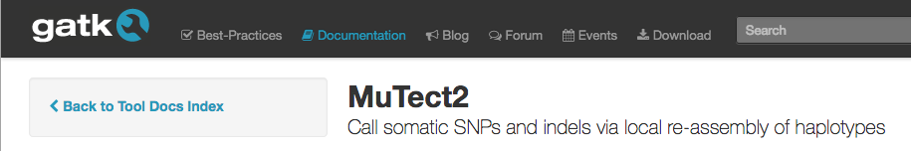
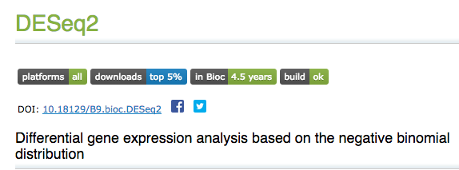
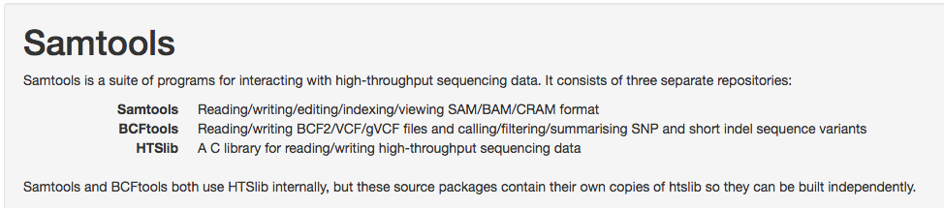

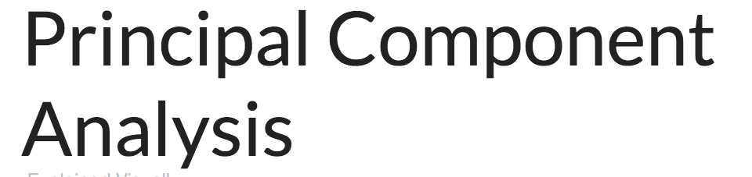
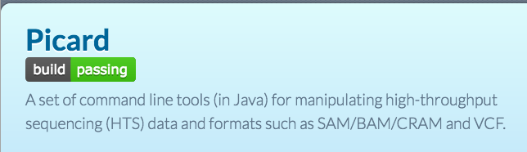

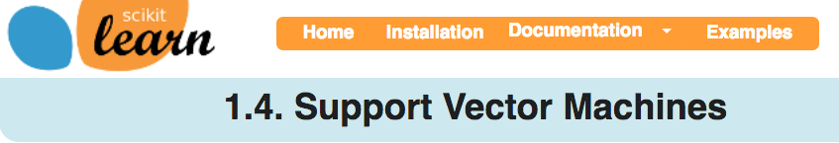

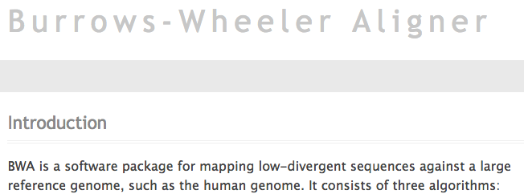
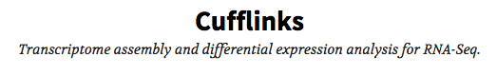
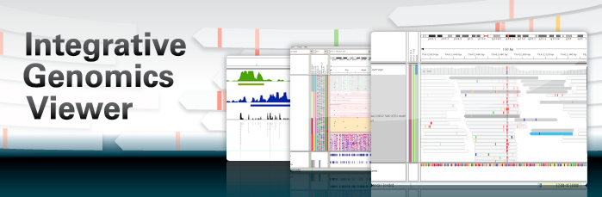
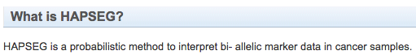
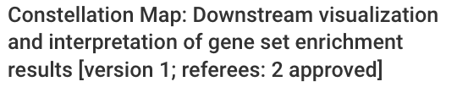
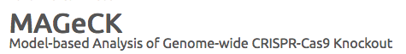
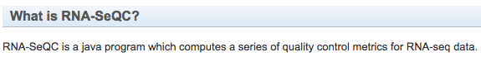
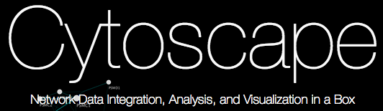
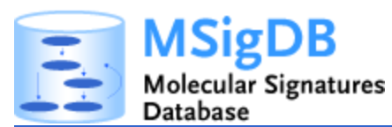

Tools for Bioinformatics

Slide 6
Problems with bioinformatics tool use and interoperability
Tools are built using different languages and with different architectural assumptions.
Each tool has its own installation and operational requirements.
Tools require (sometimes extensive) Unix knowledge.
Tools are not designed to communicate with each other.
bowtie -a --best --strata -S -m 100 -X 400 --chunkmbs 256 --fullref -p 4 Dmel.BDGP5-transcripts \ -1 SRR031714_1.fastq -2 SRR031714_2.fastq | samtools view -F 0xC -bS - | \ samtools sort -n - ~/Desktop/untreated3-transcriptome
Notes:
This is a script to align sequence to a genome and then sort the resulting alignments by genomic coordinates

Slide 7
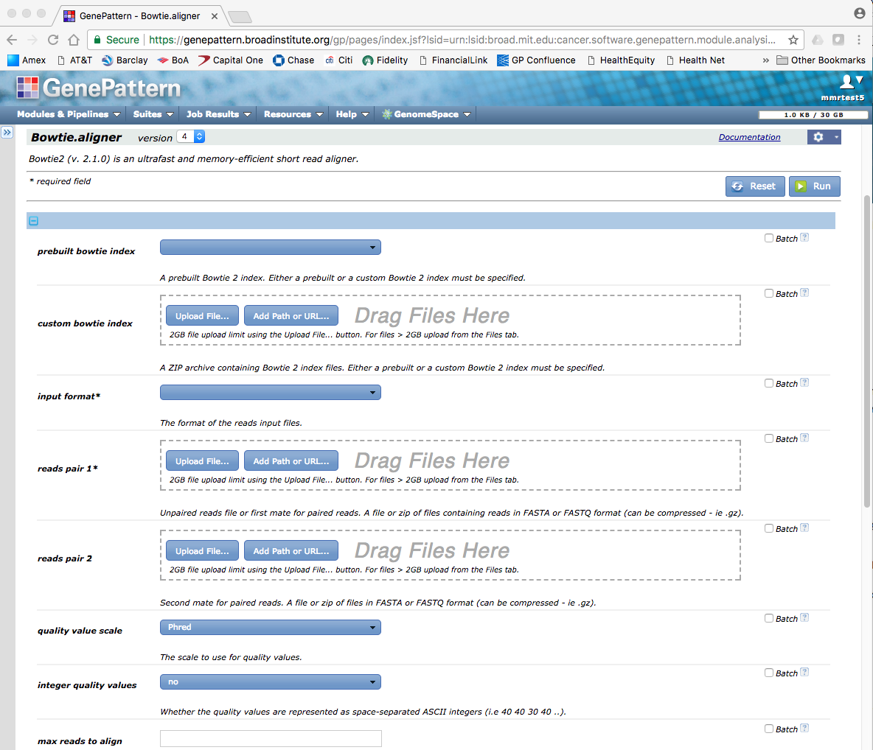
Solution features: Wrapping tools
“Wrap” tools in a web-based interface
No installation/running requirements
No programming required
Fill out required parameters and provide input files

Slide 8
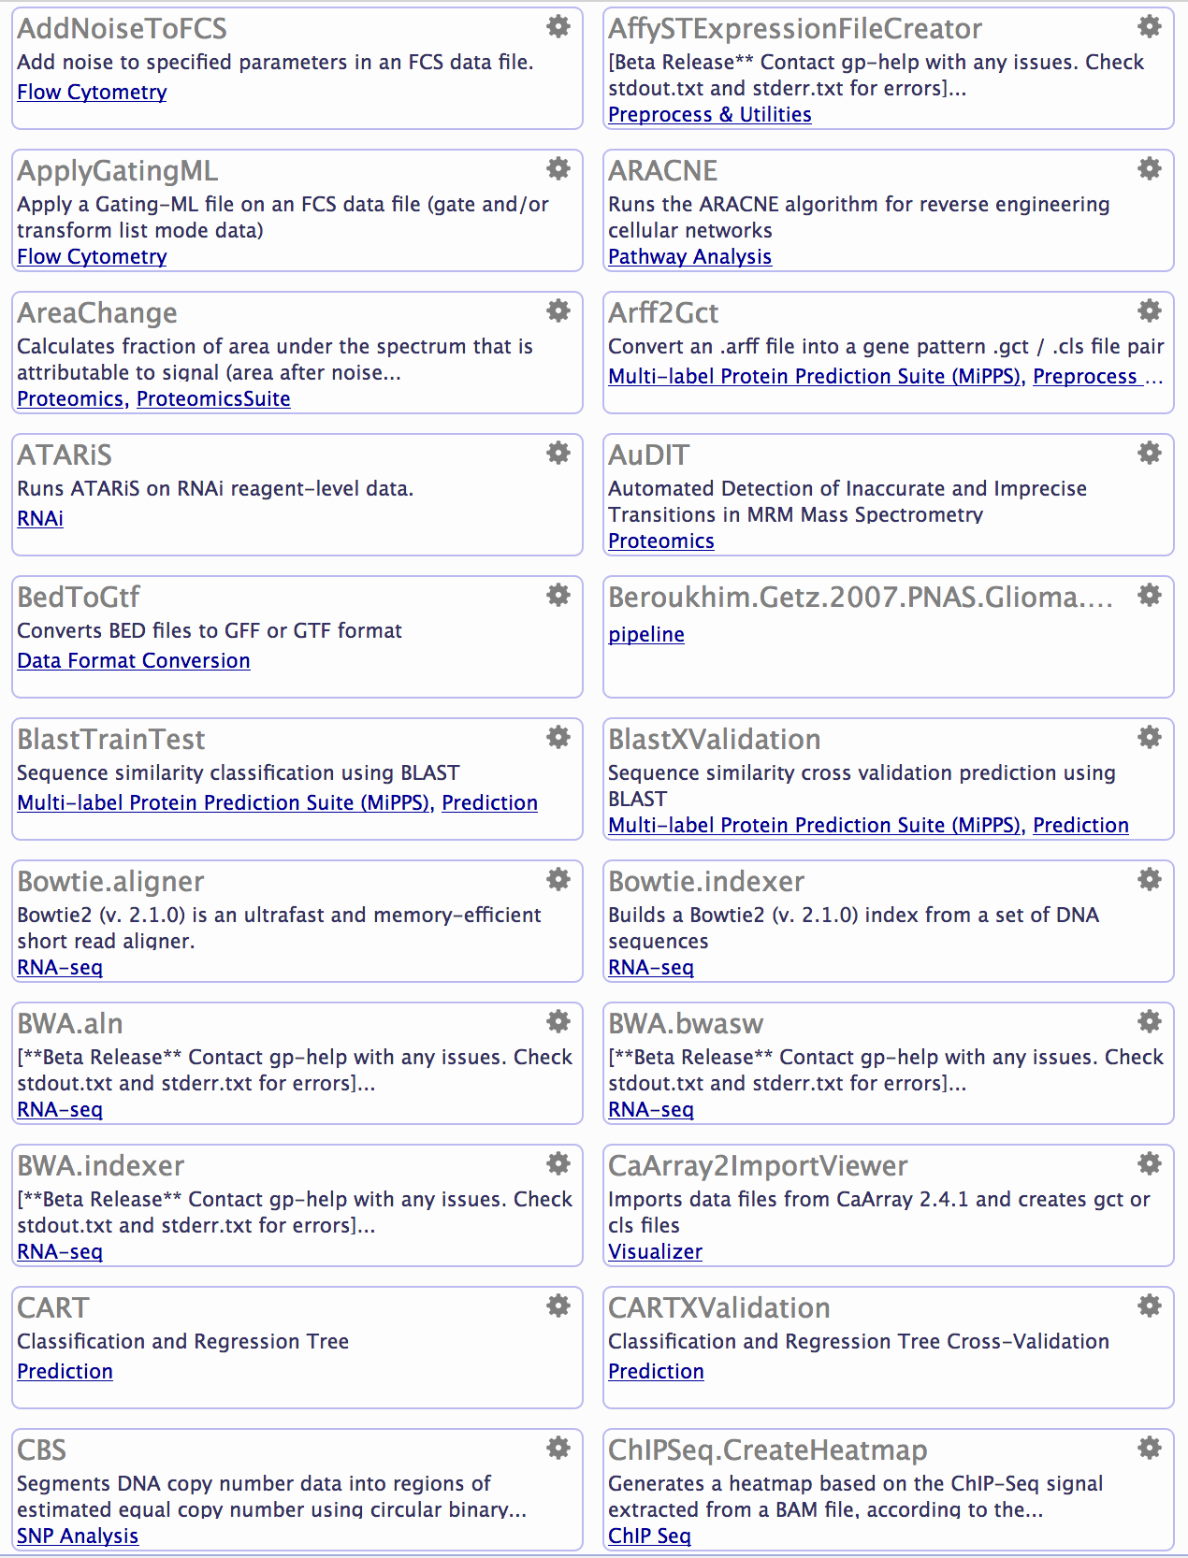
Solution features: Tool Repository
Collection of hundreds of wrapped tools
Gene expression, sequence variation, proteomics, network analysis, machine learning, flow cytometry, etc.
Searchable by name, keyword, etc.
Widely-used community tools, lab-developed tools, utilities
Users can contribute their own tools

Slide 9
Solution features: Reproducibility
Record and replay of all analyses
Retain all versions of code – so results can be reproduced even if code changes
Chain analyses into “pipelines” that can be shared and published

Slide 10
What can you do with GenePattern
Function | Description
Differential Expression | Find the genes that distinguish between two conditions (i.e., tumor vs normal, relapse vs non-relapse, etc.)
Gene Set Enrichment Analysis | Find pathways of genes that are “enriched” between two conditions
Clustering | Find subsets of a dataset (e.g., genes, samples) that are similar to one another in structure or function
Classification | Create a model that will predict the class of an unknown sample (e.g., relapse, non-relapse, etc.)
Sequence Variation analysis | Find chromosomal regions of similar copy number, call genotypes, etc.
Disease-specific analyses | E.g. genomic identification of significant targets in cancer (GISTIC), identify loss of homozygosity, etc.
Dimension Reduction | Transform your data into a lower number of dimensions to facilitate analysis
ADD MORE FOR THIS WORKSHOP
Notes:
Differential Expression
Find genes whose activity is different between two or more conditions (“marker genes”)
Tumor/normal; Different leukemia subtypes; Relapse/non-relapse; Treated with medication/untreated
GSEA: When there is no single gene that is significantly differentially expressed
Find pathways where each gene is slightly up-or downregulated
Clustering: Find out the intrinsic organization of a dataset:
Which samples of a cancer dataset are like each other; Which genes are performing similar functions; how many states there are; where are the “galaxies” and “solar systems”
Classification: If we train an algorithm with samples from patients who had their cancer relapse, come back after treatment, and those who didn’t relapse, can we use it to predict ahead of time which patients are likely to relapse?
Sequence Variation: In diseases like cancer, chromosomes undergo a tremendous amount of rearrangement. How do those rearrangements affect the activity of the genes on those chromosomes?
Dimension Reduction: When we’re measuring gene activity, we are recording the state of 20,000 genes – that’s like a single point with 20,000 vectors. If we have let’s say 100 samples, that’s basically like solving 100 equations that have 20,000 unknowns. But – dimension reduction methods can often get our dataset down to just a few dimensions that represent most of the variation in a dataset.

Slide 11
GenePattern vocabulary: Modules
Copy Number
Divide
by Normals
GSEA
Variation
Filter
GISTIC
CBS
k-Nearest
Neighbors
Classification
and
Regression Trees
Support
Vector
Machines
Hierarchical
Clustering
GISTIC
Expression
File
Creator
Metagene
Projection
Notes:
We’ll be talking a lot about modules. A module is a piece of code that someone wrote to perform some analysis, such as the ones you see here. Those analyses would typically need you to be programmers in order to use them, or at least familiar with using the command line. GenePattern has a mechanism to wrap these programs so they have an easy to use web-based interface.

Slide 12
GenePattern vocabulary: Modules
Copy Number
Divide
by Normals
GSEA
Variation
Filter
Hierarchical Clustering
Files
HCL.jar
cluster.exe
ant.jar
gp-modules.jar
Jama-1.0.2.jar
Documentation
HierarchicalClustering.pdf
Parameter descriptions
-f <input.filename>
<log.transform>
<row.center>
<row.normalize>
<column.center>
<column.normalize>
-u <output.base.name>
-e <column.distance.measure>
-g <row.distance.measure>
-m <clustering.method>
GISTIC
CBS
k-Nearest
Neighbors
Classification
and
Regression Trees
Support
Vector
Machines
Hierarchical
Clustering
GISTIC
Expression
File
Creator
Metagene
Projection
Notes:
Modules are self-contained – they can go from one GP server to another, and almost all of the official ones can run on any platform – Windows, Mac, Linux

Slide 13
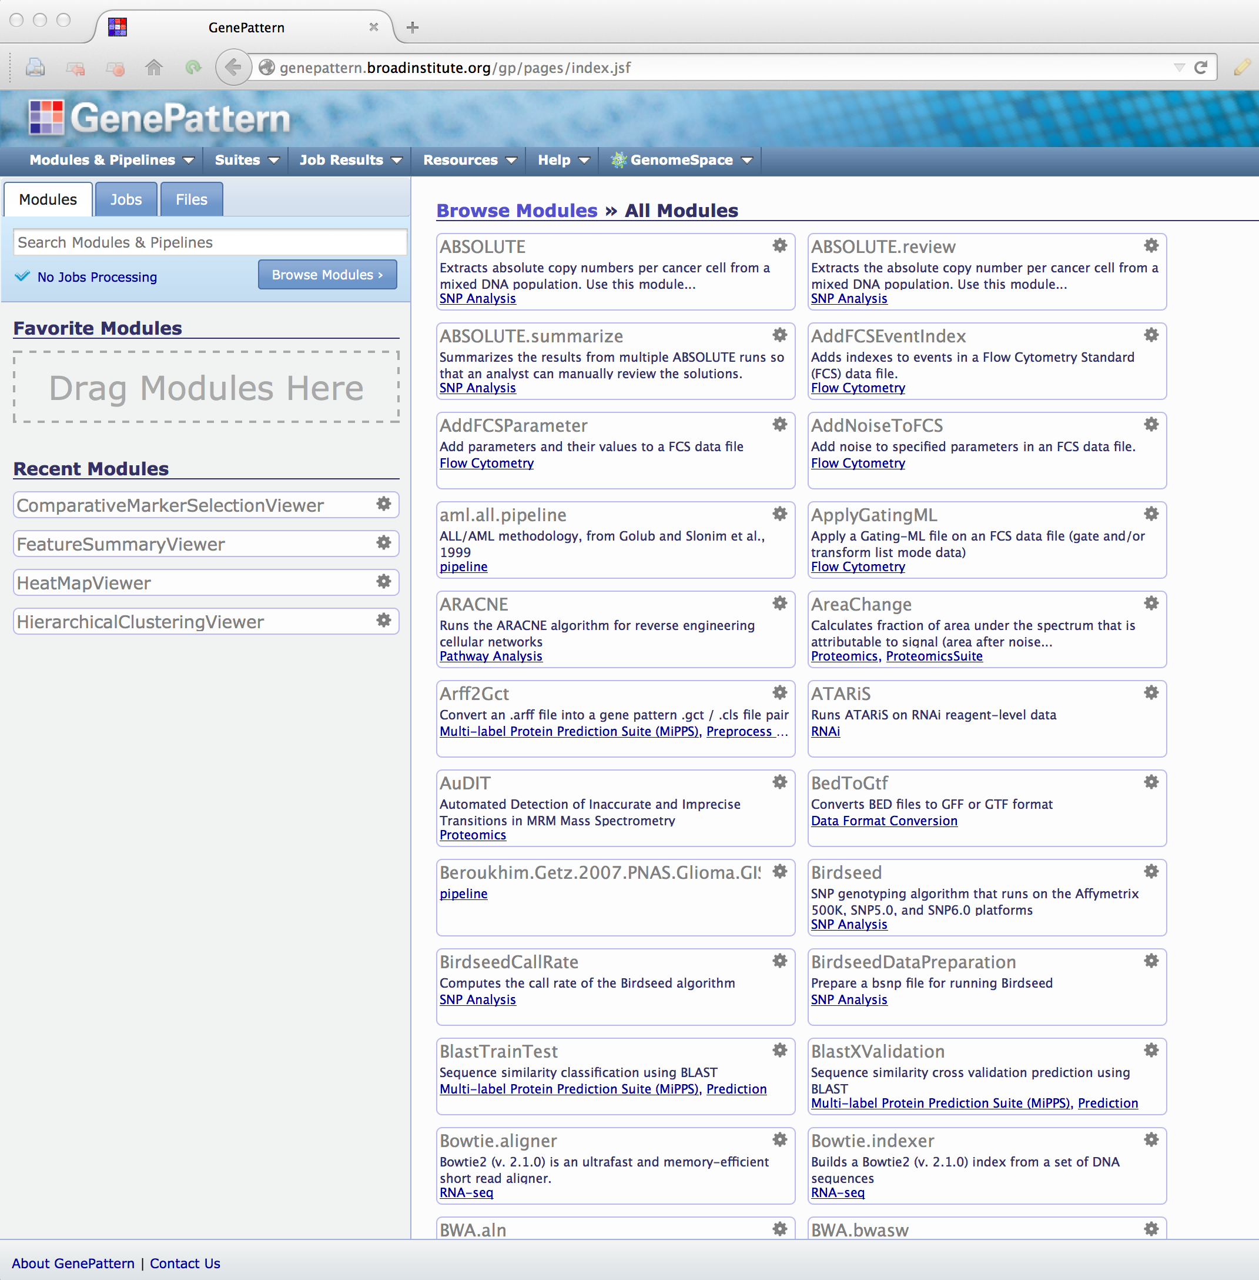
>250 GenePattern Modules, 3/2018
Notes:
There are currently over 250 modules available in the official version of GenePattern, with more being added on a regular basis.

Slide 14

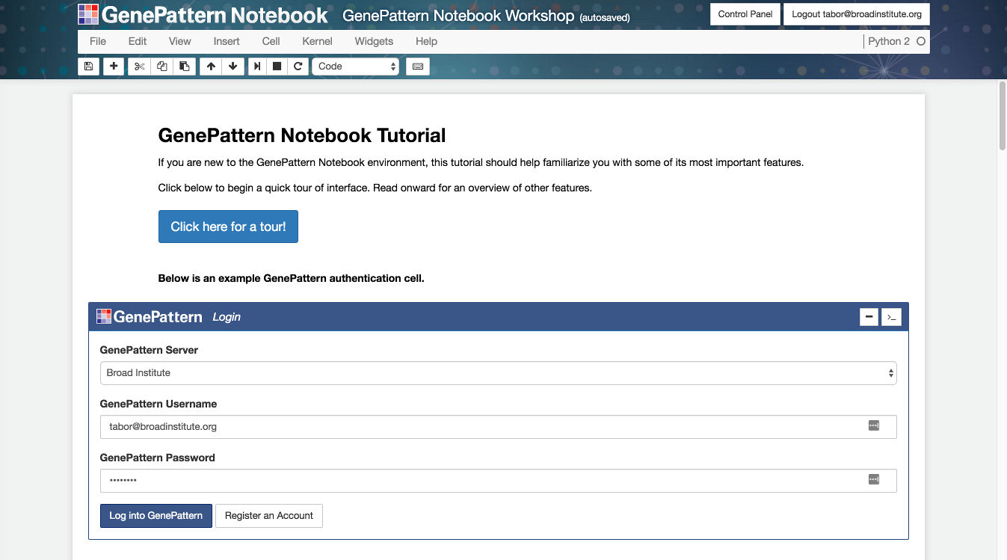
GenePattern Notebook Environment
Notes:
At this point you should have a high-level, rather abstract idea of what GenePattern is and what its goals are. This is important because it lays the groundwork for the rest of the workshop today.
.
In this section, however, we’re going to dive and get our hands dirty, using GenePattern to run a computational genomic notebook.
This will use one of GenePattern’s newest features – the GenePattern Notebook Environment. This environment allows you to perform in silico research and present that research in the form of an interactive notebook in your web browser.
.
It also allows you to easily reproduce research conducted by others and encapsulated in a notebook document.
.
You can also think of the GenePattern Notebook like this: If you work in a wet lab, a bench biologist has an ever-present lab notebook. For computationalists, however, there is no real equivalent. GenePattern Notebook helps bring these worlds together, so that you can keep your notes and your computational analyses together in an easy-to-understand, narrative format.
.
And this format is really intuitive. It’s a lot like how you might conceive of your research. And it's also not unlike how an academic paper might be structured.

Slide 15

Jupyter Notebook
Popular and well-supported framework for scientific computing
Ecosystem of available extensions and resources
Open source
Notes:
GenePattern Notebook is built on top of a platform called Jupyter.
.
Jupyter is a popular and well-supported framework for scientific computing with a pretty vast ecosystem of integrations and other resources that are available.
.
It's open source software.
.
And the GenePattern Notebook Environment lets you create bioinformatic notebooks that are compatible with it and all the associated resources that are available to you.

Slide 16




Complete Research Narrative
Leverages the best of Jupyter and GenePattern
Interleave text, visualization, graphics and analytical aspects
Notes:
One of the underlying goals of GenePattern Notebook is to encapsulate a complete research narrative—from its conception to dissemination.
.
Another goal is to make all of the powerful GenePattern features available in the notebook environment. This way a researcher can leverage the best of what Jupyter and GenePattern has to offer, interleaving text, graphics, interactive visualizations and analytic aspects.

Slide 17
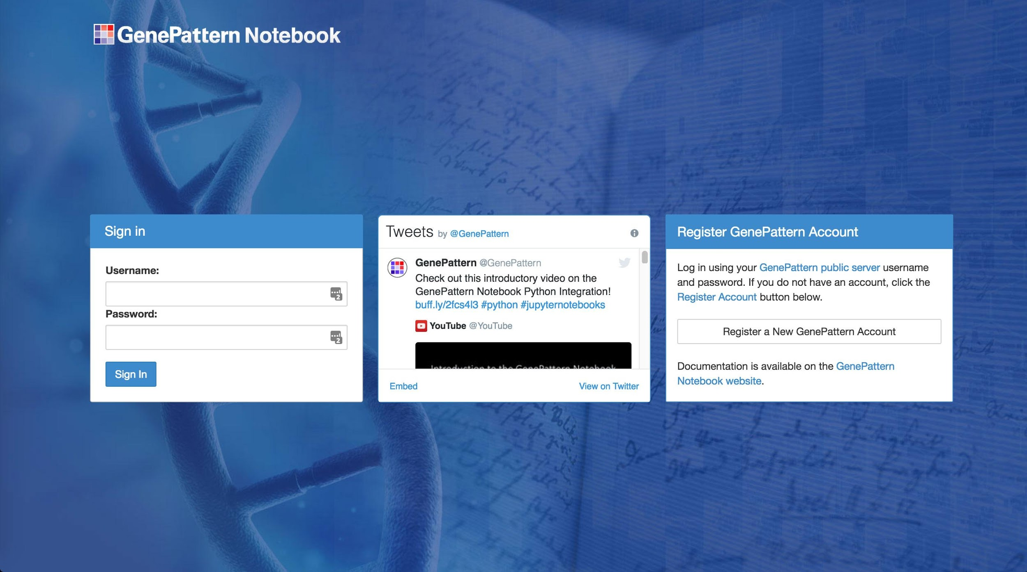
GenePattern Notebook Repository
https://notebook.genepattern.org
Notes:
When go to the web address you should have seen a login page that looks something like the one I’m showing up on the screen.
.
Welcome to the GenePattern Notebook Repository. This is a free online resource that lets you develop, share and publish computational genomic notebooks. You can use it with your own research, or you can use it to browse through the public notebooks in the repository and use them to reproduce a variety of popular methods.
.
And as you can see, there’s a “Register an Account” button in the righthand box, and the login form on the left.
Before we can do that, however, each of you first needs to register for an account – if you haven’t already done so. After you register, it should automatically log you in to the GenePattern Notebook Repository
.
So if you haven’t already, go to the web address you see up on the screen and register for an account.
.
**Give them some time to do this.**

Slide 18
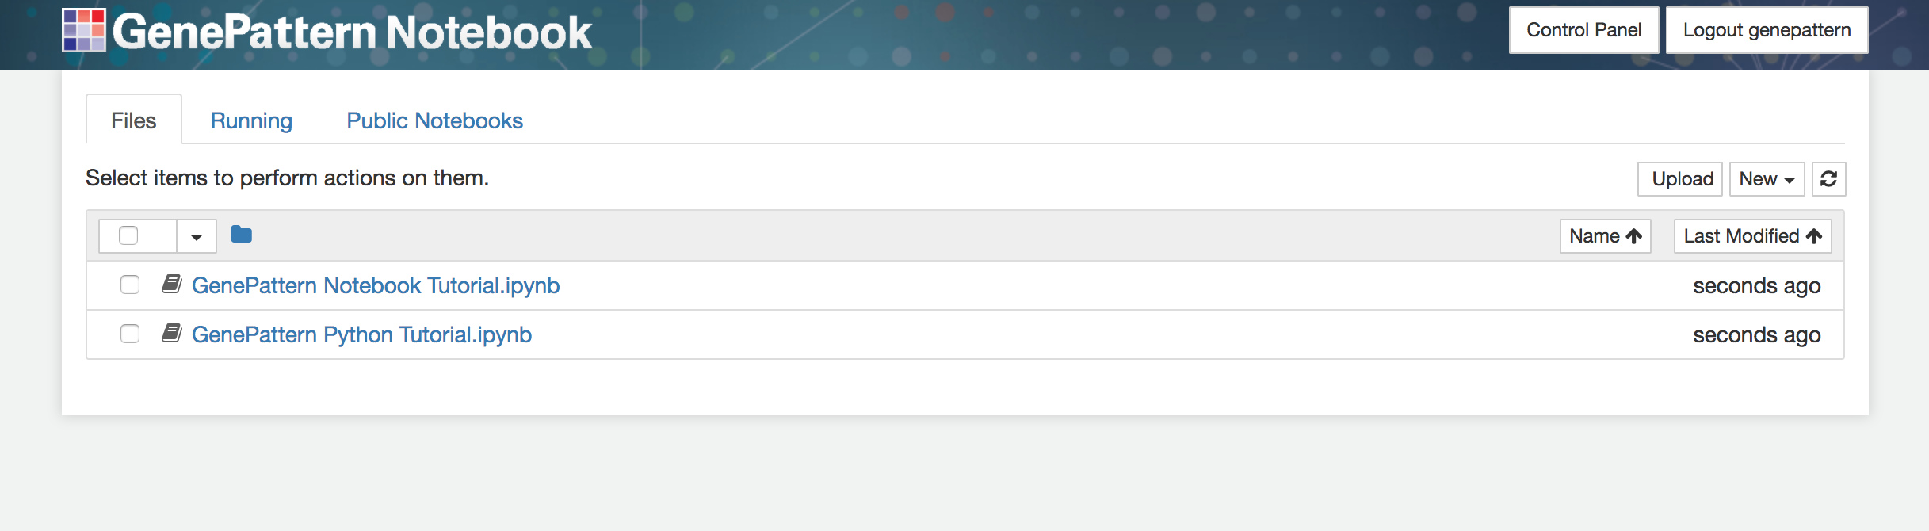
Notebook Workspace
Lists your private notebooks and associated files.
Copy, move, rename, delete, download and publish notebooks from here.
Notes:
Once you’ve registered, it should automatically log you in and bring you to a page that looks like the one you see up on the screen now.
.
On this page you should see a list of the notebook files you have in your personal and private workspace. By default you’re going to have two files when you first register, and these are both tutorial notebooks that show off the available features.
.
Later you can run them at your leisure, but what we’re going to do now, however, is to browse the list of published notebooks for the method that we want to reproduce.

Slide 19
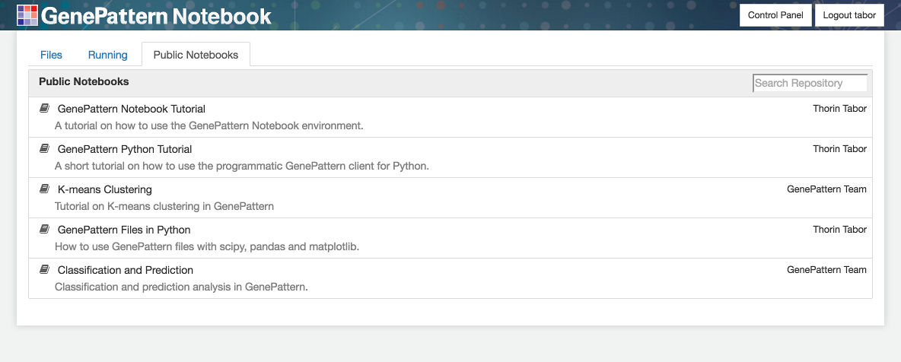
Browse Public Notebooks
A variety of public notebooks are available in the GenePattern Notebook Repository.
Anyone can make a copy of these notebooks to read, run and reproduce.
Notes:
You will notice that on the current page there are a number of tabs near the top. Right now we’re on the Files tab, which shows your notebook files, but there is also a Running tab and a Public Notebooks tab.
To browse the available public notebooks, we’re going to click on the Public Notebooks tab and look through the list. You will notice that if you hover your mouse over the name of each notebook in the list, it will display a short description.
These notebooks cover a variety of topics, from how to use the GenePattern Notebook environment itself, to common biological or machine learning tasks, such as differential expression analysis, clustering, classification and prediction.
However, we’re going to start with something very basic. So go ahead and locate the 2017-12-15_01 CCMI GenePattern Notebook notebook in the list and then click it.
**Demonstrate how to grab a copy of a notebook.**

Slide 20
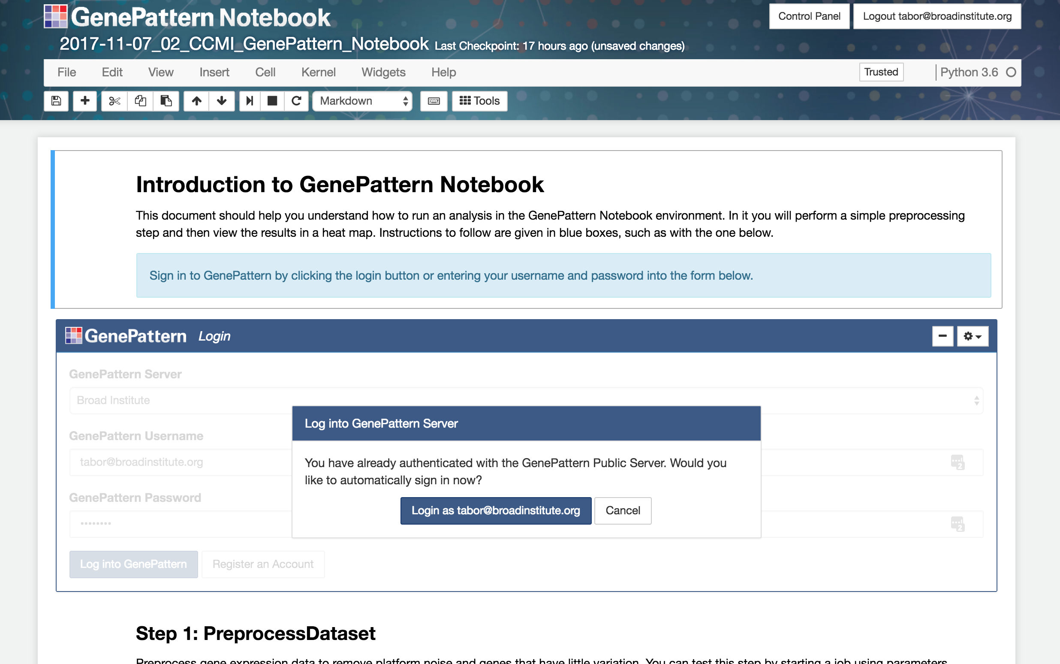
Run an Analysis Notebook
2018-03-14_01_UCSF GenePattern Notebook Introduction
Notes:
Once you have made a copy of the notebook and opened it, you will be brought to a new tab displaying the contents of the selected notebook..
.
It should look something like what you see up on the screen.
.
Has everyone caught up to this point? **Wait and see**
.
Okay, then I’m going to go ahead and explain what you’re seeing in this notebook.

Slide 21
Understanding Notebooks
Notebooks encapsulate a workflow, including analysis, documentation and other considerations, so that it can be easily reproduced.
To achieve this, all notebooks are backed by a “kernel,” which is a complete contained computational environment.
The kernel provides programmatic capabilities for users who want to code, and also allows for for interactive widgets for users who don’t want to code.

Slide 22
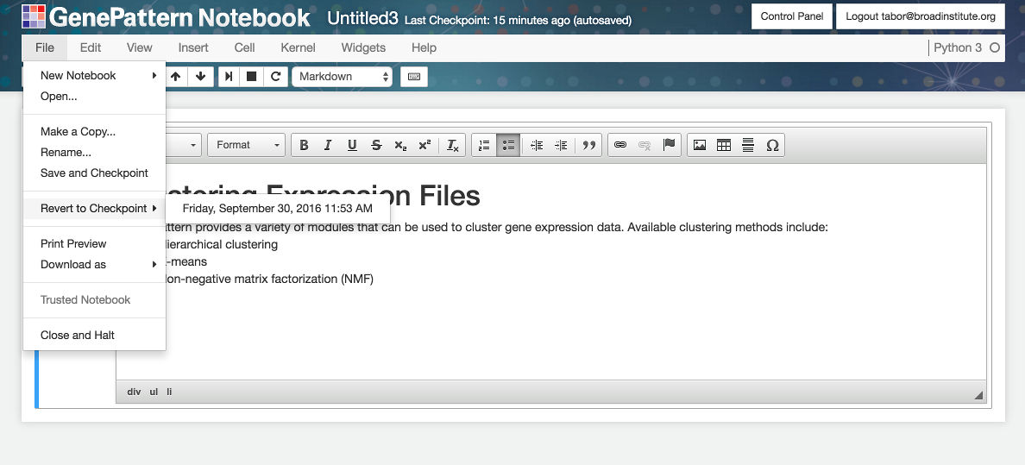
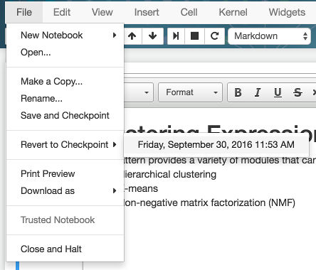
Name, Save & Checkpoint Notebooks
Name or rename notebooks
Save or revert to a checkpoint
Make a duplicate notebook
Notes:
Finally, no discussion of notebook functionality would be complete without mentioning the ability to save, or revert to a saved checkpoint.
.
This works just like saving and checkpointing in Microsoft Word or similar word processor. Both features are available in the File menu at the top of a notebook.
.
You can also name or rename a notebook by clicking on the title at the top, and then giving it a name at the prompt.
.
**Demonstrate these things.**

Slide 23
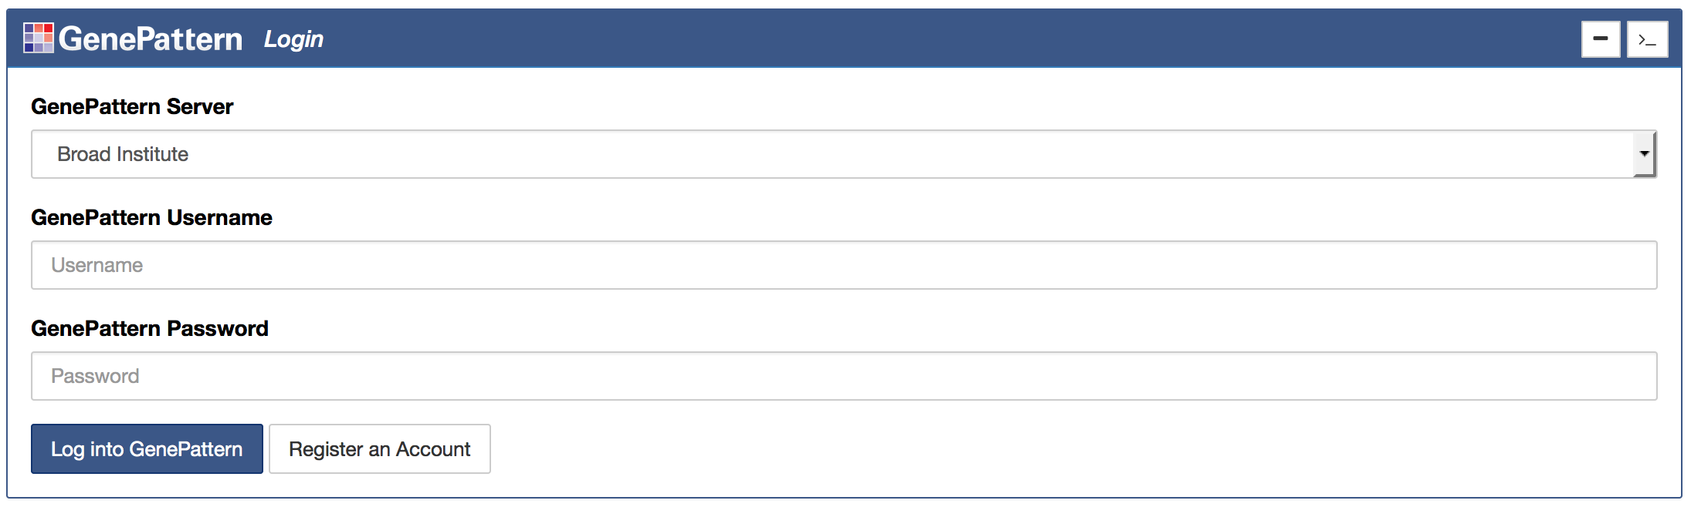
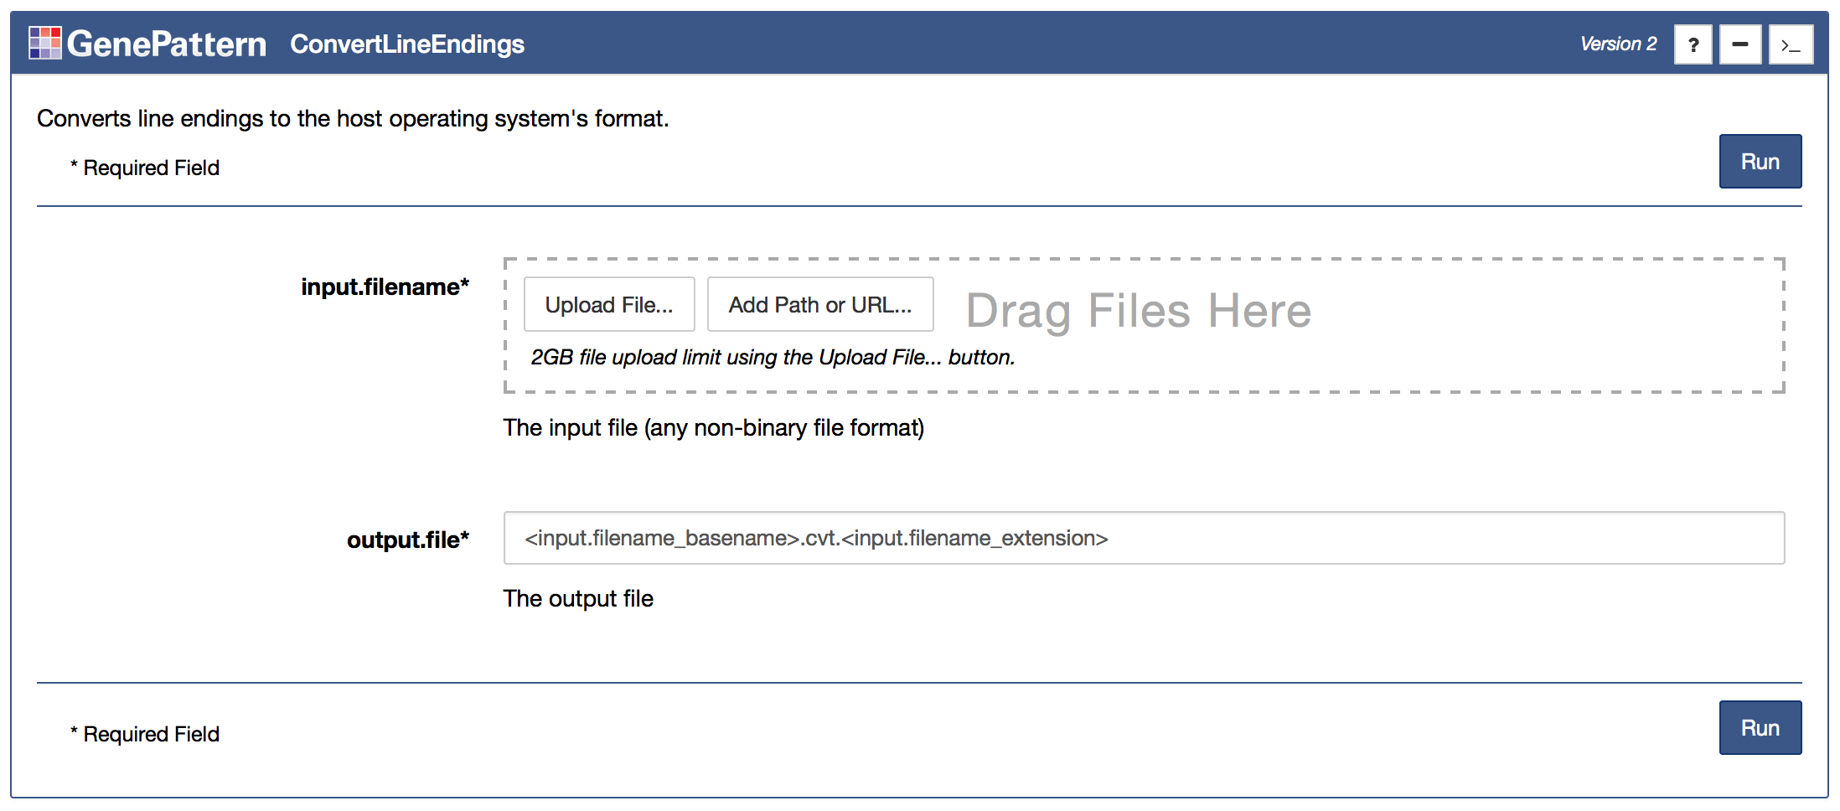
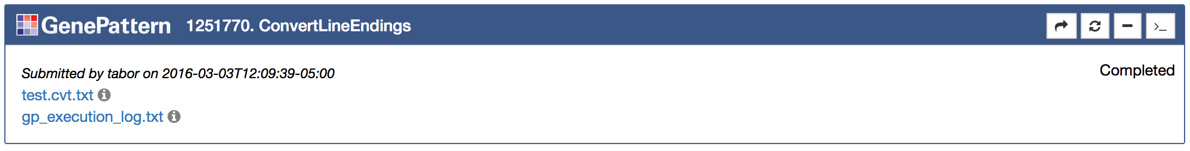
GenePattern Cells
Auth
Cell
Analysis
Cell
Job
Cell
Notes:
One of the key features provided by the GenePattern Notebook environment are GenePattern cells. These cells are rendered as interactive widgets that provide the functionality of GenePattern inside the notebook environment.
.
And there are three subtypes of these cells.

Slide 24
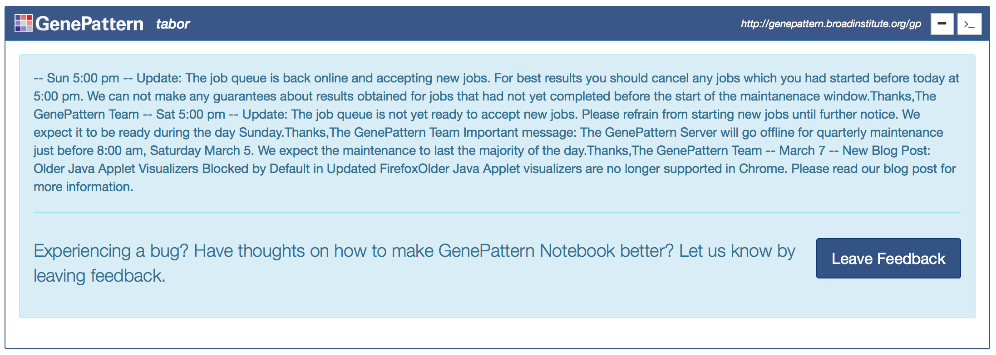
Authentication Cells
Notes:
The first, and perhaps least interesting, of these types are authentication cells.
.
These cells allow a researcher to authenticate with a GenePattern server.
.
Doing this allows data sent to the server to be kept private, or even shared with other users.
.
You will notice that the first GenePattern cell you see in the notebook is one of these authentication cells. Since you’ve already logged into the GenePattern Notebook Repository, the cell should currently be displaying a dialog asking you if you want to log in as the same user. You do, so go ahead and click the “Login as your username” button.
.
You will notice that when you do this, the authentication cell will change to display a status message from the server. And the other GenePattern cells in the notebook will also update.
.
**Give people a moment to login.**

Slide 25
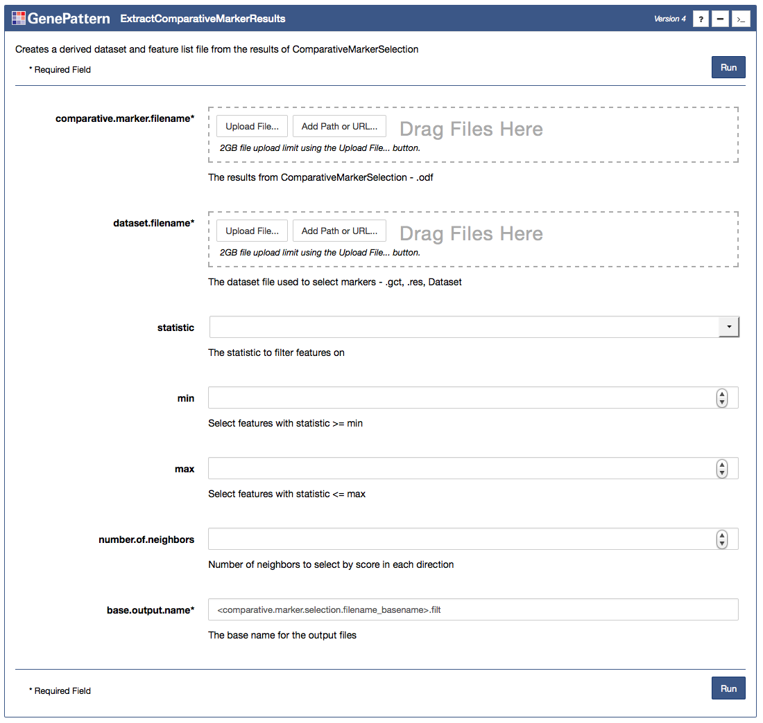
Analysis Cells
Notes:
The next type of GenePattern cells are analysis cells. And as you scroll down in this notebook, these are the other cells you see with the GenePattern logo at the top.
.
Each of these cells represent a particular analysis module in the GenePattern environment, and they each provide a simple form with the different input settings for that analysis.
.
These allow a researcher to upload data or set other parameters.
.
For example, the first one of these you see - PreprocessDataset -is for an analysis module that preprocesses data, cleaning it up for further analysis. For example, it can remove saturation effects, reduce noise or other random fluctuations, filter out genes that don’t significantly differ, etc.
.
For the purposes of this exercise, the form has already been filled out, but we want to go ahead and change one setting – the minimum fold change.
.
You will notice the instructions for that in the blue box. In fact, in all the notebooks today, the instructions you should follow will be in blue boxes like this one.
.
All you need to do is set the min fold change parameter to the correct value, then click the Run button to launch the analysis. So I want all of you to go ahead and do that now.
.
**Give them some time to do this.**

Slide 26
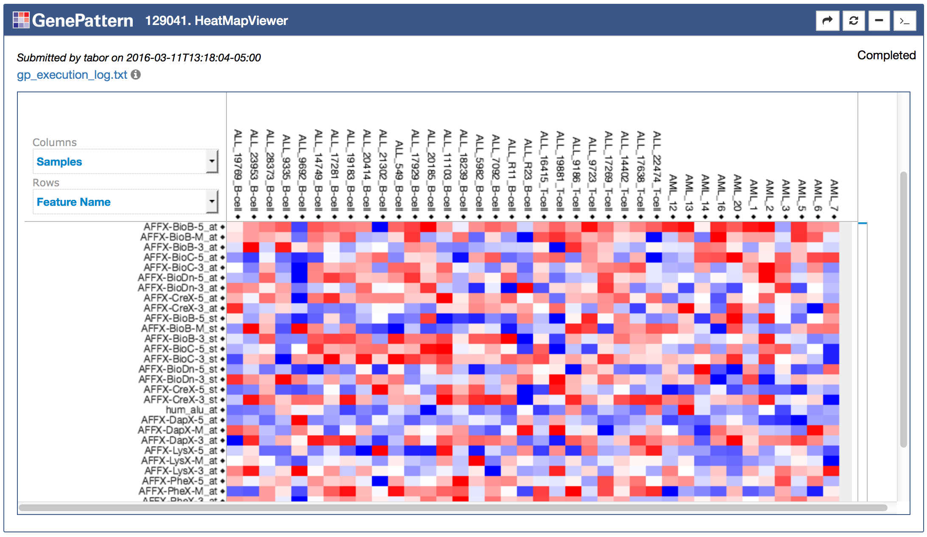
Job/Result Cells
Notes:
The third and final type of GenePattern cell is the job cell. These cells are used to retrieve the results of submitted analyses. The results can be in the form of outputted files, such as with the top screenshot, or the results can be in the form of interactive visualizations, as with the bottom screenshot.
.
If you’ve been following along, you’ve already clicked the Run button for the PreprocessDataset analysis. And when you clicked that button it should have created one of these cells below the initial analysis cell.
.
As GenePattern jobs process they go through a series of states First they are pending, as the job waits its turn in the queue to run. Then the job is running—that is, the analysis is currently processing. And finally the job progresses to either the Completed or Error state.
.
If you look on the righthand side of the job cell, you should see your job’s current status. Output files or visualizations will appear once the job reaches the Completed state.

Slide 27
Running GenePattern Notebook
Run using the GenePattern Notebook Repository.
Install on your own computer by installing through the pip or conda package repositories.
A GenePattern Notebook Docker image is available.
Notes:
And now for my final slide of this section of the workshop:
.
I want to note that the GenePattern Notebook environment can be ran in a variety of different ways.
.
The first way you’ve already seen—using the GenePattern Notebook Repository. This method allows you to open a notebook in your browser and run it, no installation required.
.
For those of you who prefer to run notebooks locally, may do so as well. GenePattern Notebook can be installed as an extension for Jupyter, through either the pip or conda package repositories.
.
Finally, we’ve made a Docker image of GenePattern Notebook available. It’s already configured and ready to go. And publicly available on DockerHub..
.
**Introduce Ted for the Data Preparation section.**

Slide 29


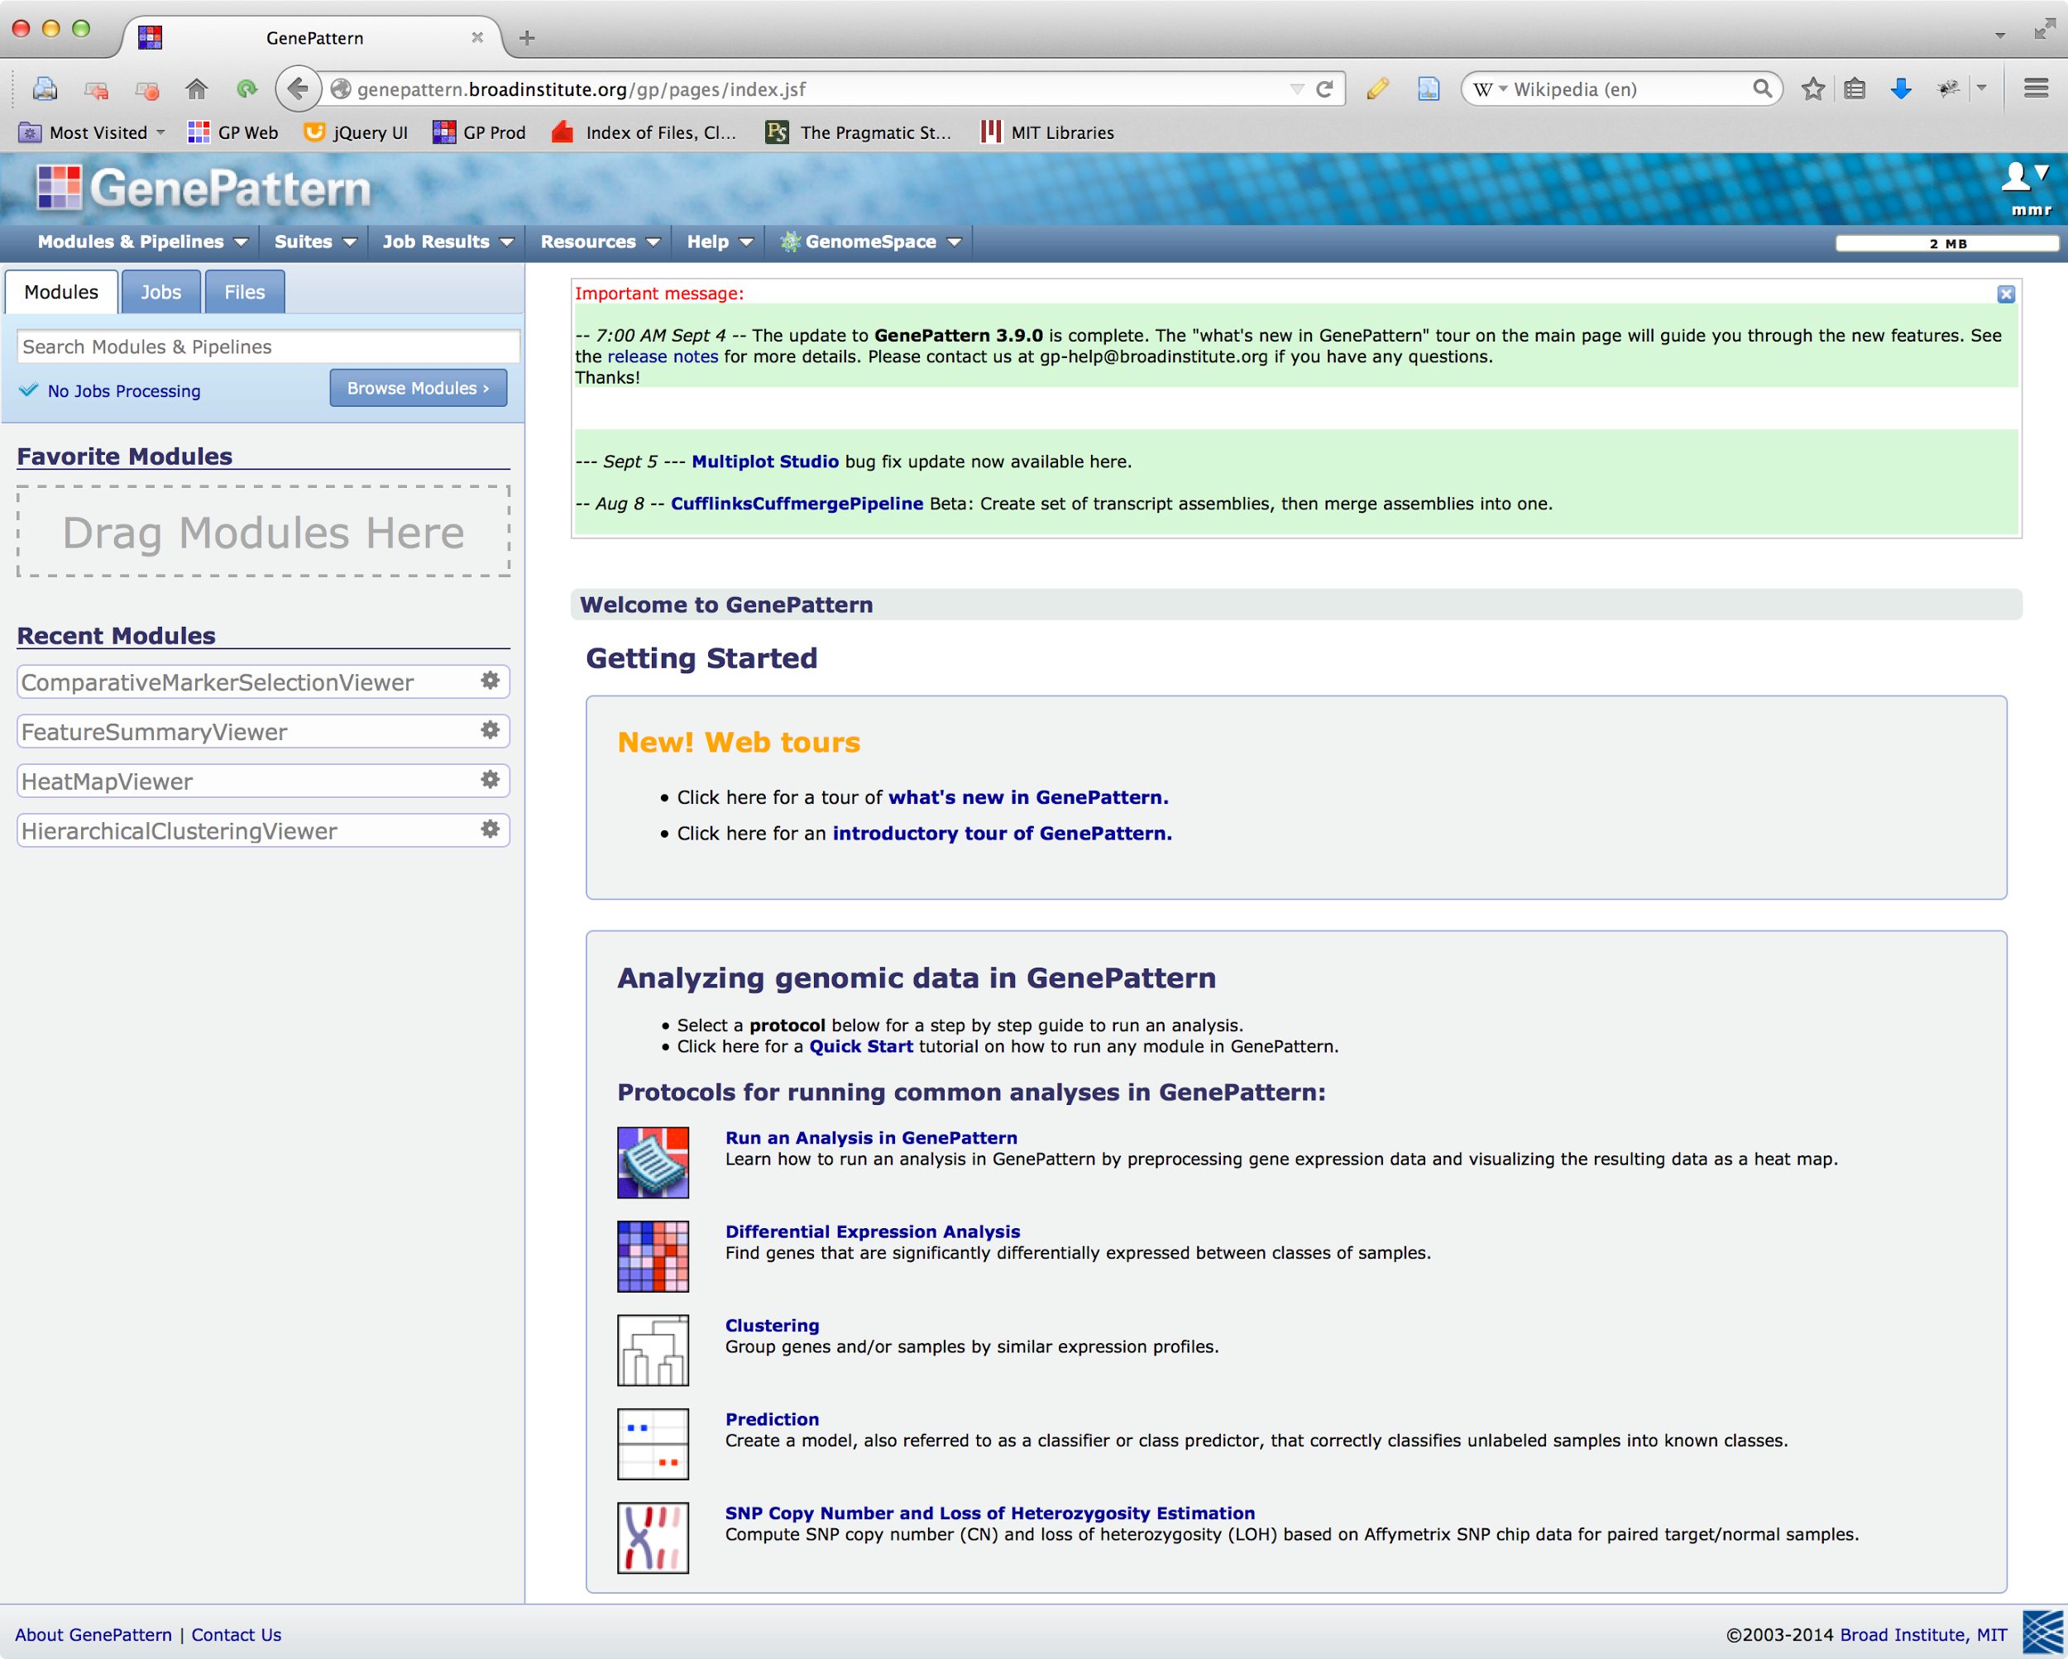

How GenePattern works
Repositories
Servers
GenePattern Users
GenePattern Server
Production
Repository
Modules
Pipelines
Jobs
Beta
Repository
Local GP Server
Modules
Pipelines
BETA
Jobs
Community
Repository
Local GP Server
Modules
Pipelines
Jobs
Notes:
This slide shows how the parts of GenePattern interact with each other and also
You can think of module repositories as individual iTunes stores..

Slide 30
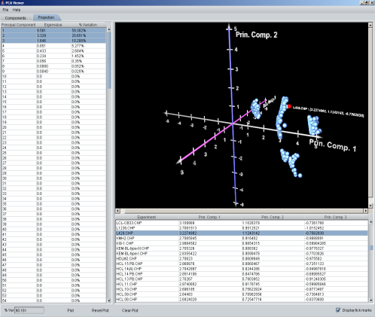
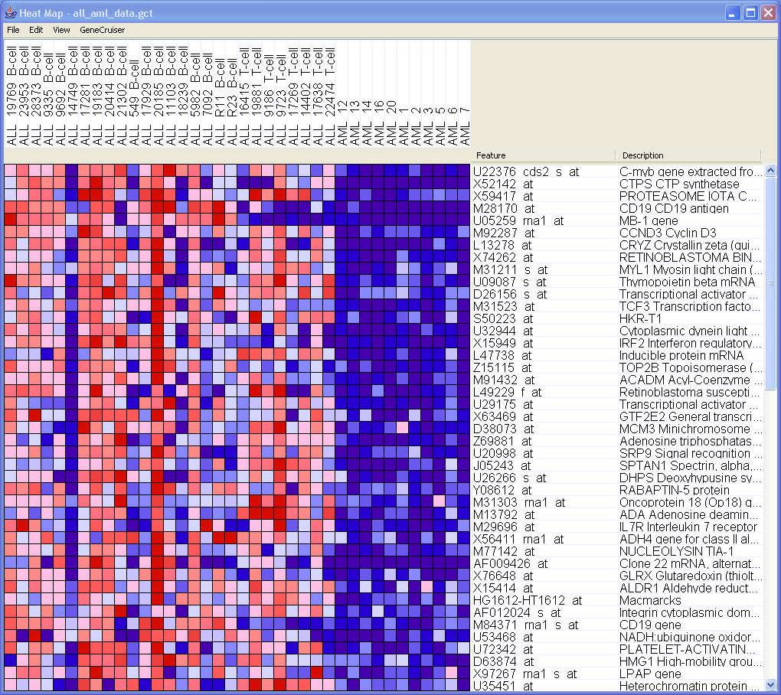
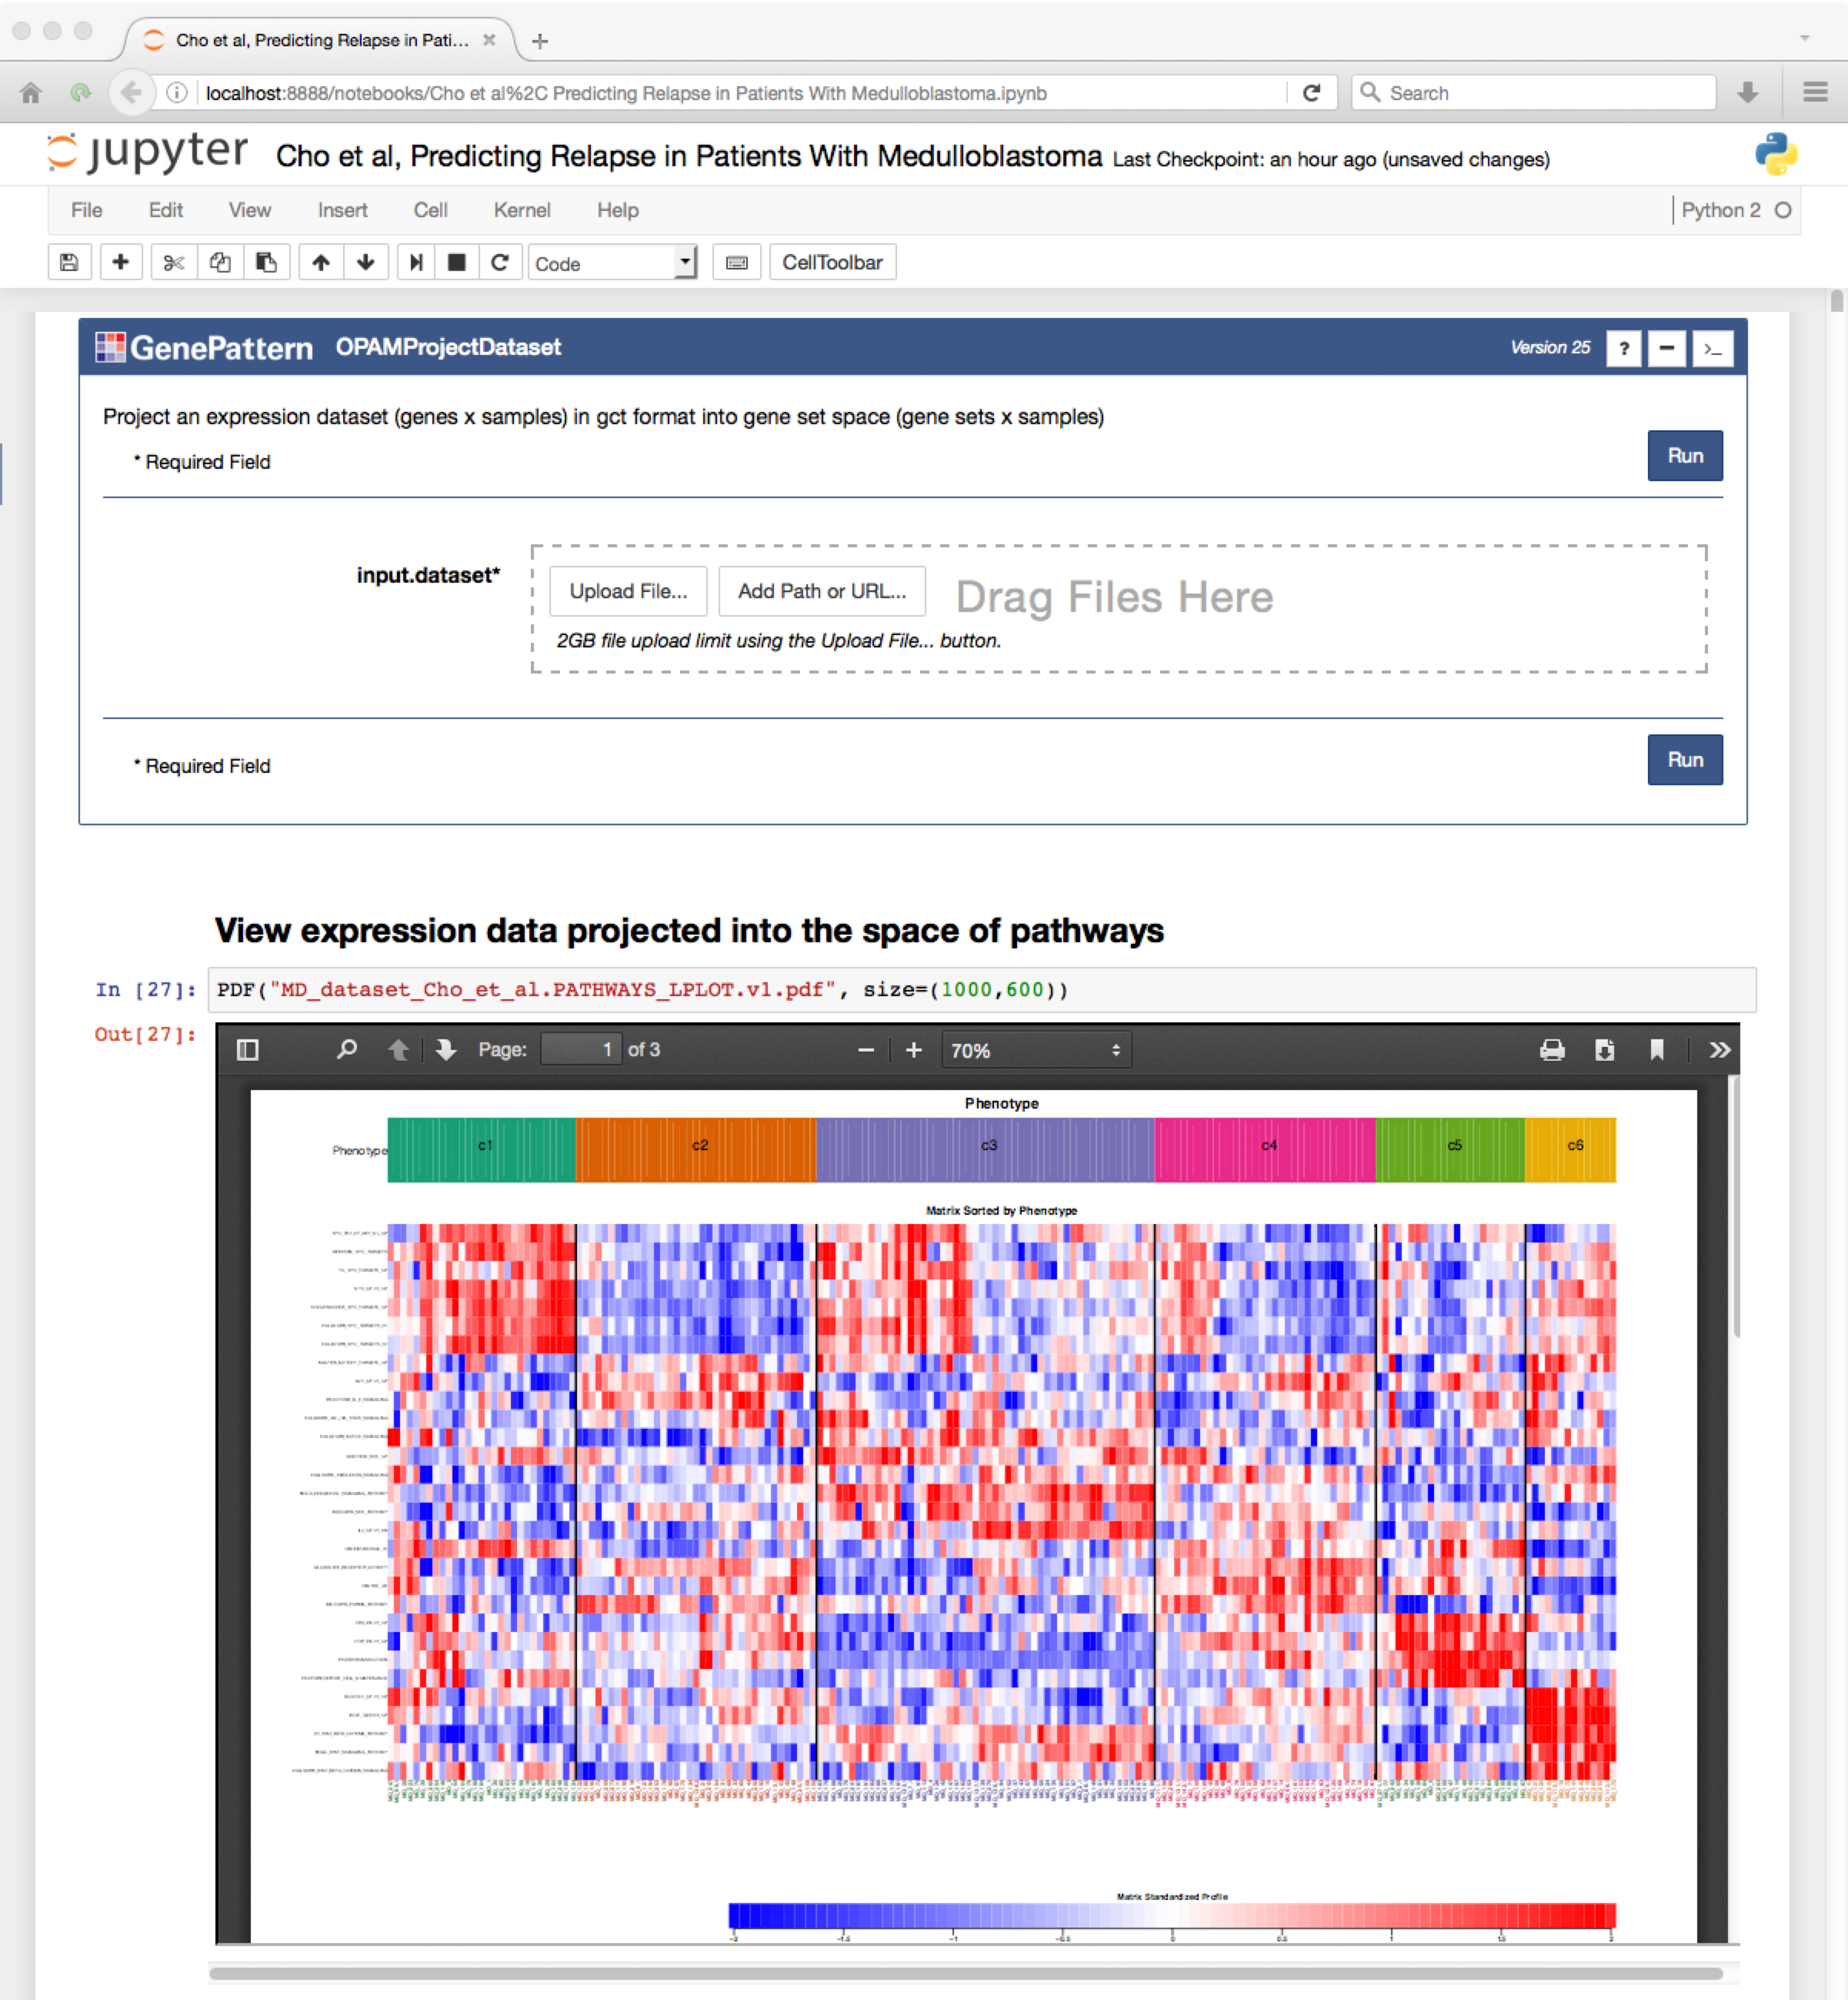

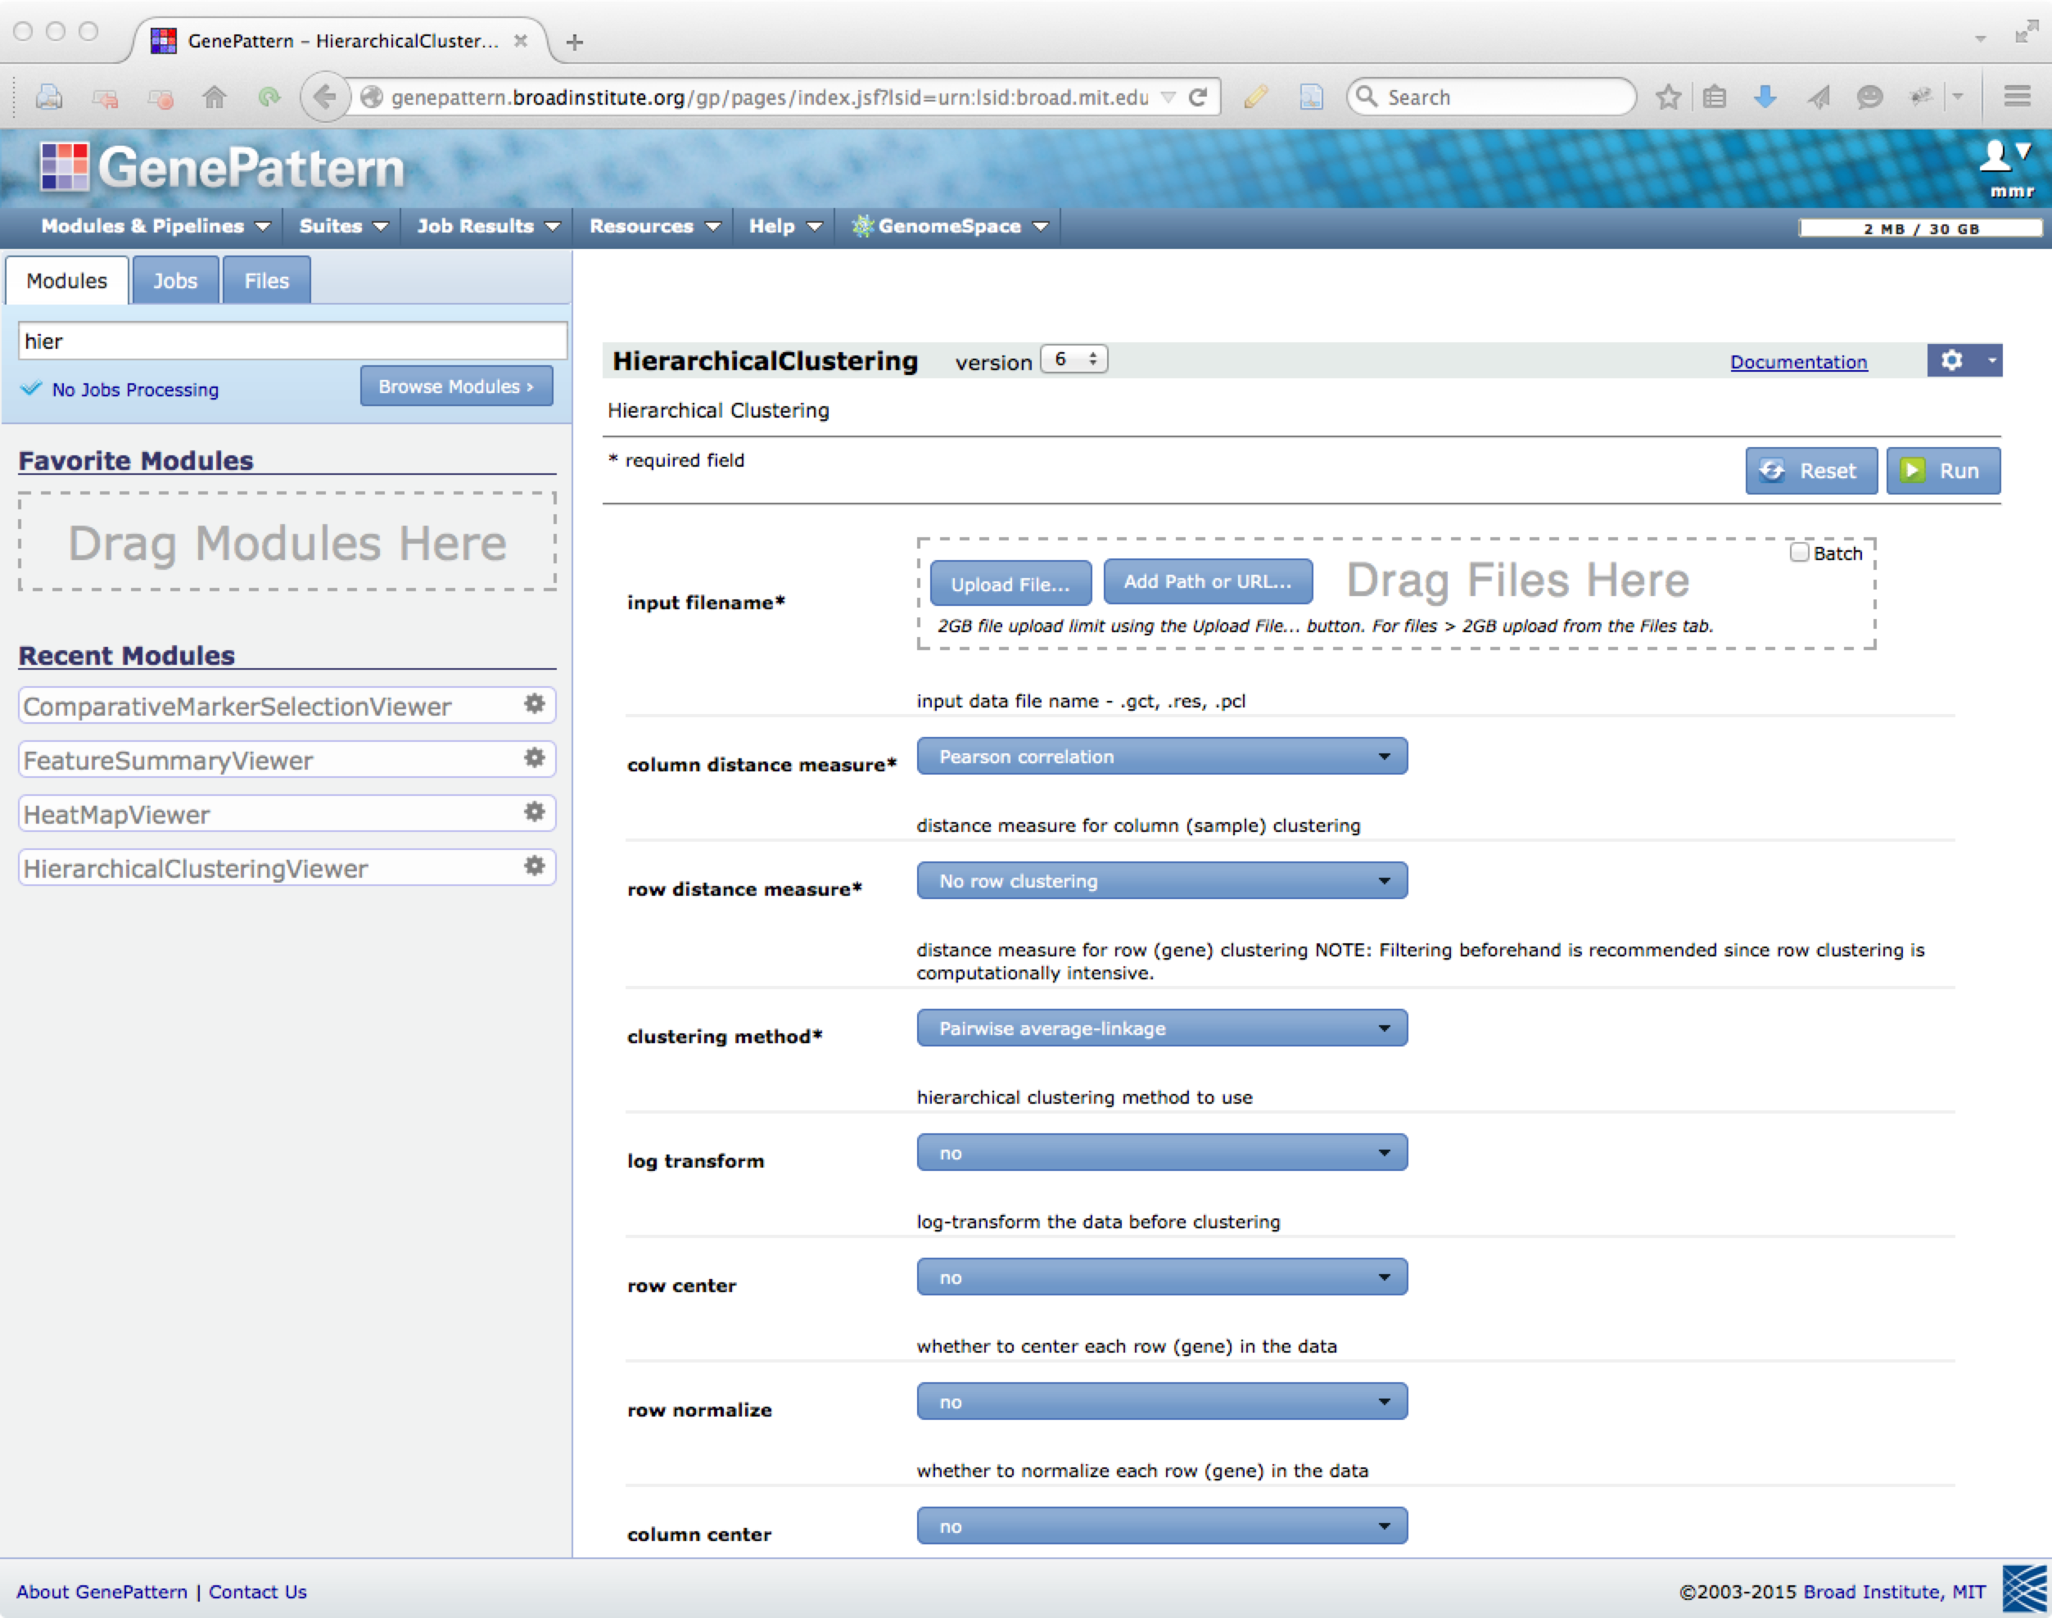
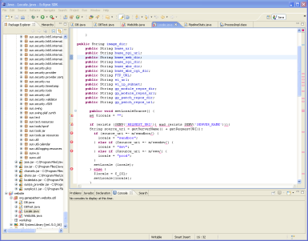
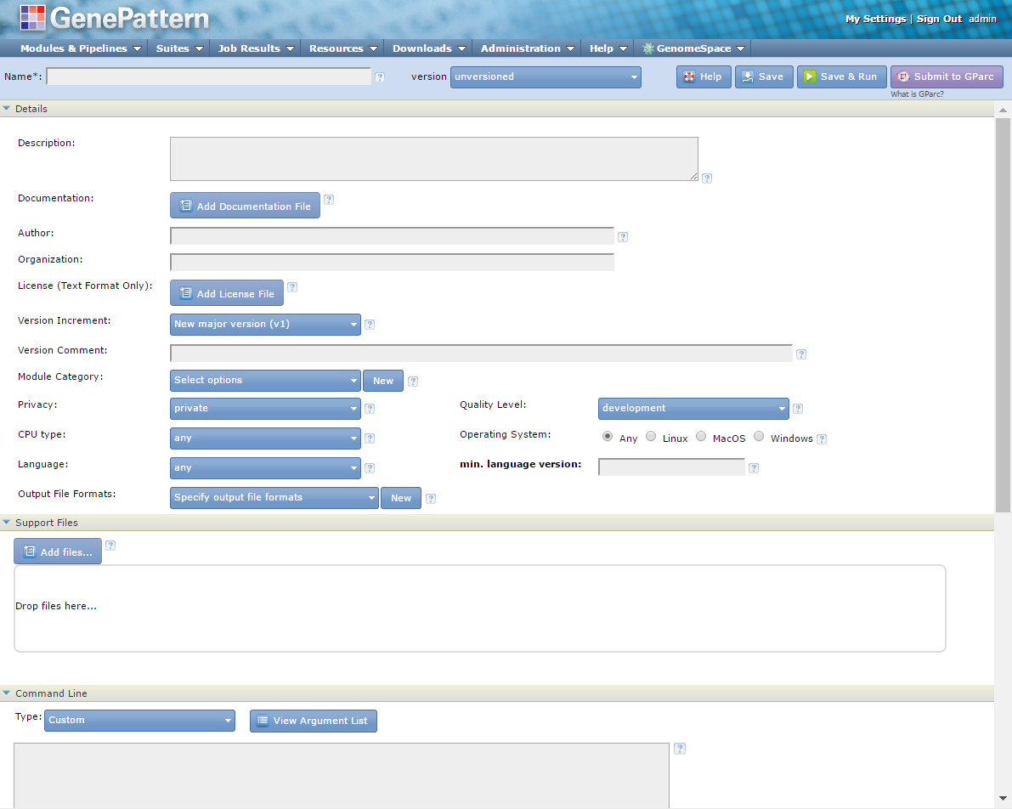
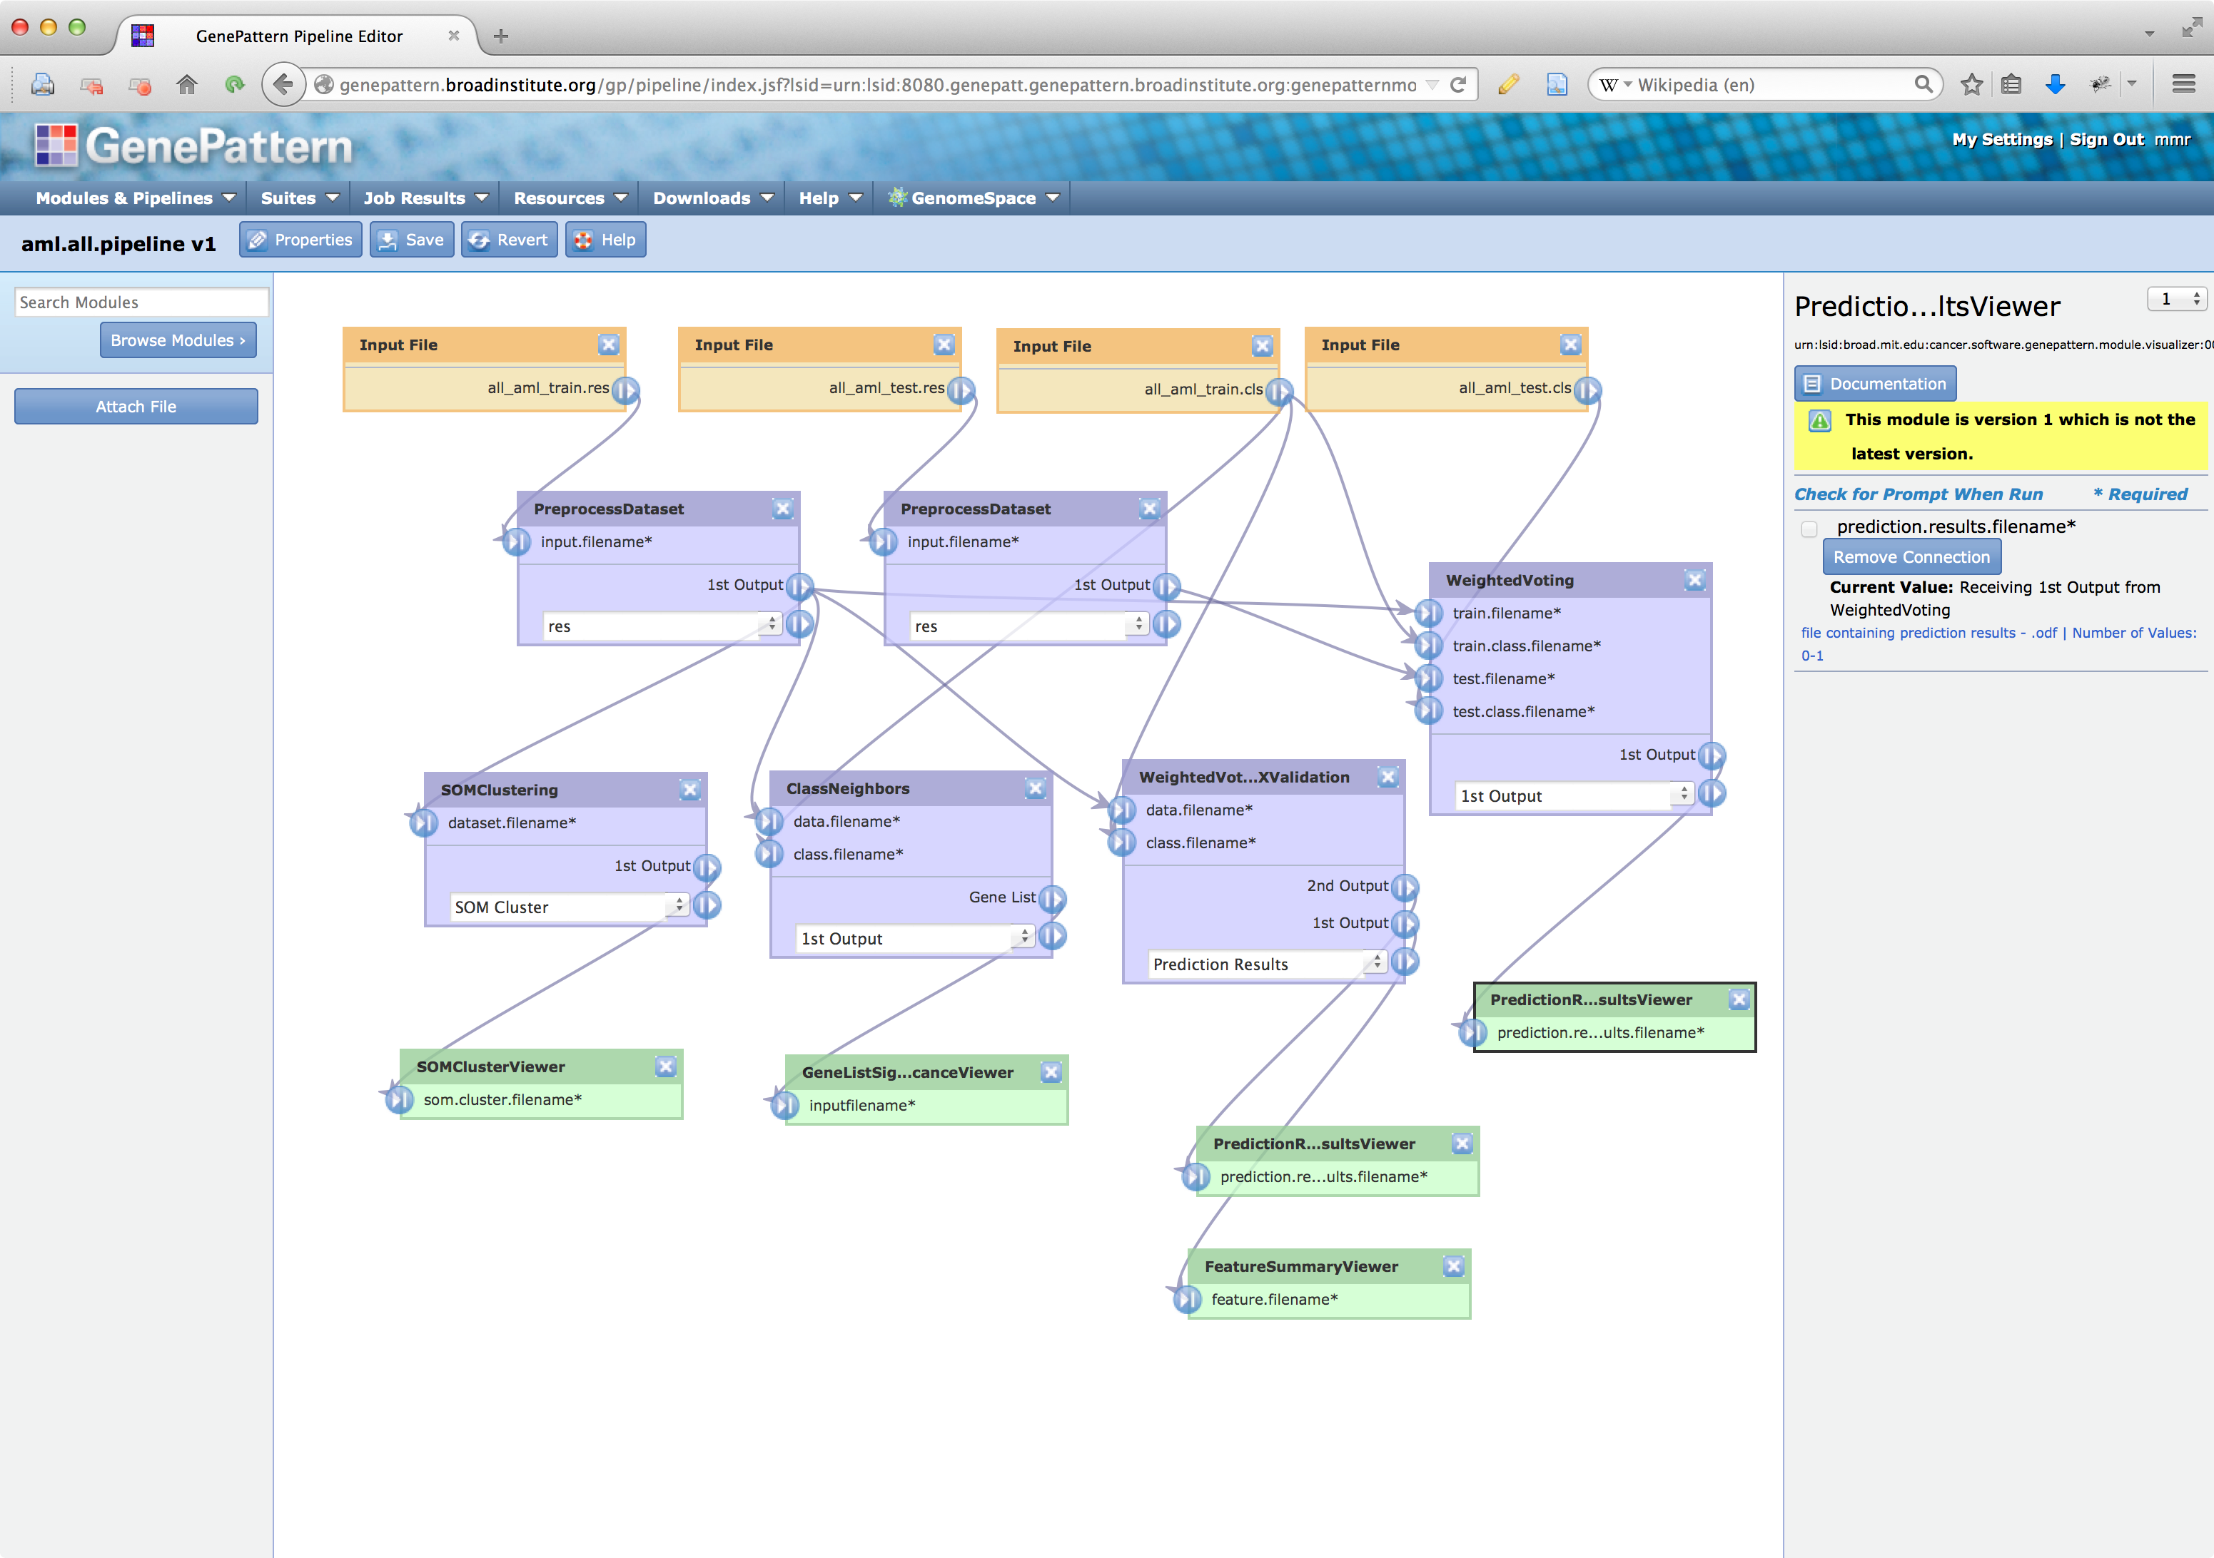
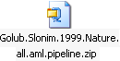
The GenePattern Ecosystem: Architecture
Module Repository
Clients
NMF
Cuffdiff
MuTect
…
GISTIC
GSEA
Tophat
…
Hundreds of analysis and visualization tools
Pipeline Environment
Analysis Engine
training dataset
test dataset
Notebook
Preprocess
Preprocess
Record/replay analyses
Versioning of methods
Web service access
SOM Clustering
Class
Neighbors
Weighted
Voting
Cross-Val
Weighted
Voting
Train/Test
Web
SOM Cluster Viewer
Marker Selection
Viewer
Prediction
Results
Viewer
Prediction
Results
Viewer
Module Integrator
Golub and Slonim et. al 1999
Programming
Support for in silico reproducible research
Easy addition of new tools
Access for all levels of user
Notes:
30
A platform for integrative genomics that supports tool interoperability and reproducible in silico analyses. It does this through:
Comprehensive set of analyses- gene expression, sequence variation, proteomics, as well as technology platform-specific modules, with visualization tools for each available datatype
Ability to add new tools without programming – users can add tools to their own GenePattern installations to create their own specialized GenePattern servers
A pipeline environment that records the analysis steps taken and can chain them into pipelines that can be shared, reproduced, and published
Interface accessible to all levels of user
Released GP Notebook environment last year
What kind of community has evolved from this ecosystem?

Slide 31


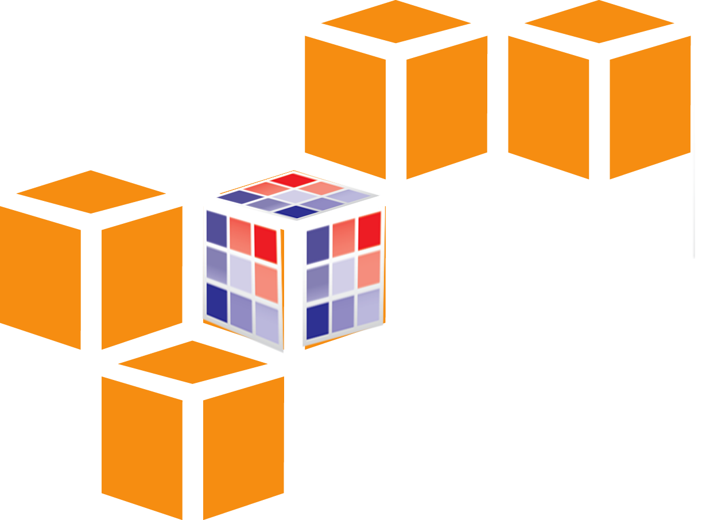



Availability
Public server at Broad Institute (genepattern.broadinstitute.org)
Public server running on Amazon Web Services (beta) (gp-dev-ami.genepattern.org)
Public server at Indiana U, backed by Mason HPC cluster (gp.indiana.iu)
Downloadable server (laptop to compute farm) (www.genepattern.org)
Amazon Machine Image (AMI)
Notes:
GenePattern is available on several public servers, providing accessibility with only a Web browser as a requirement.
This year we announced GenePattern running on the Indiana University’s Mason supercompute resource, providing substantial additional compute and storage for the intensive analyses that increasingly require it
We are also collaborating with PSC and TACC to create a gateway that would provide a GenePattern server that has access to the combined supercompute capabilities of those sites.

Slide 32
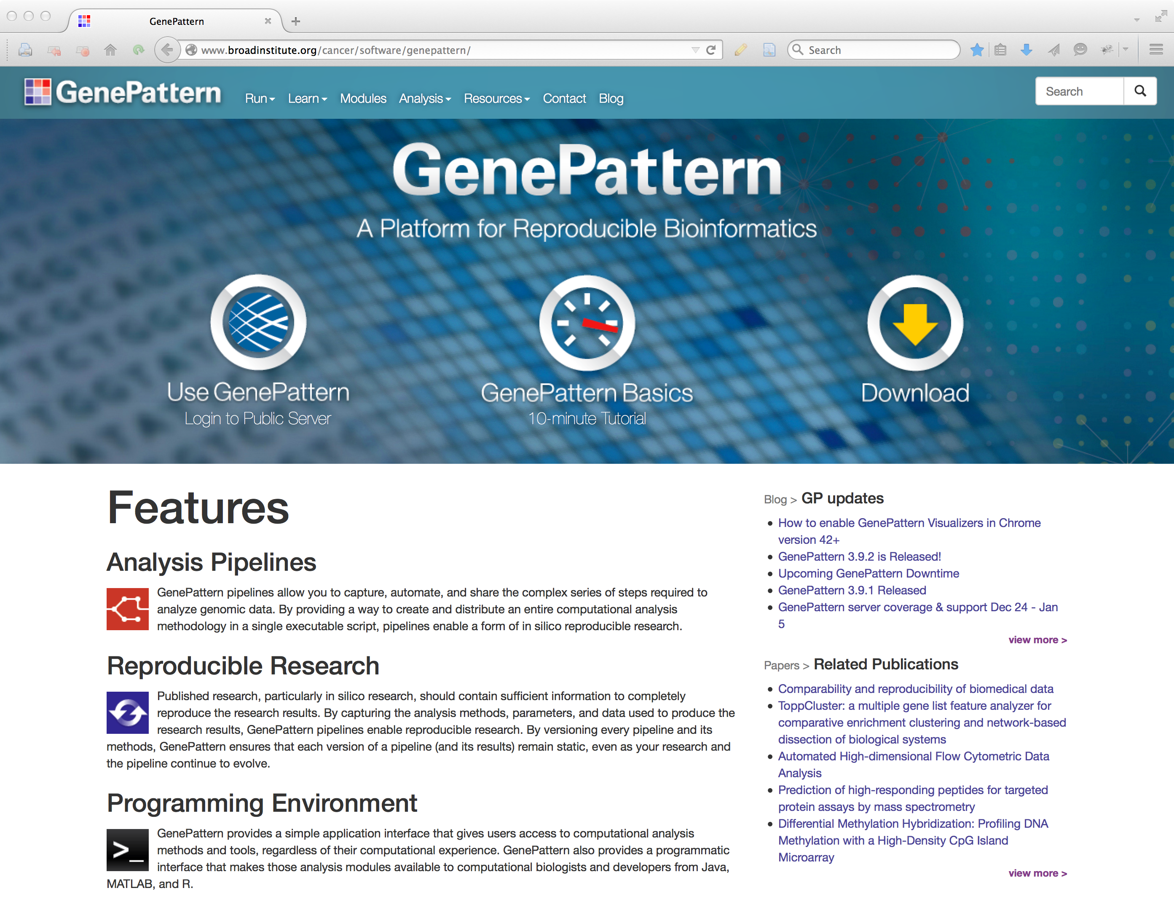
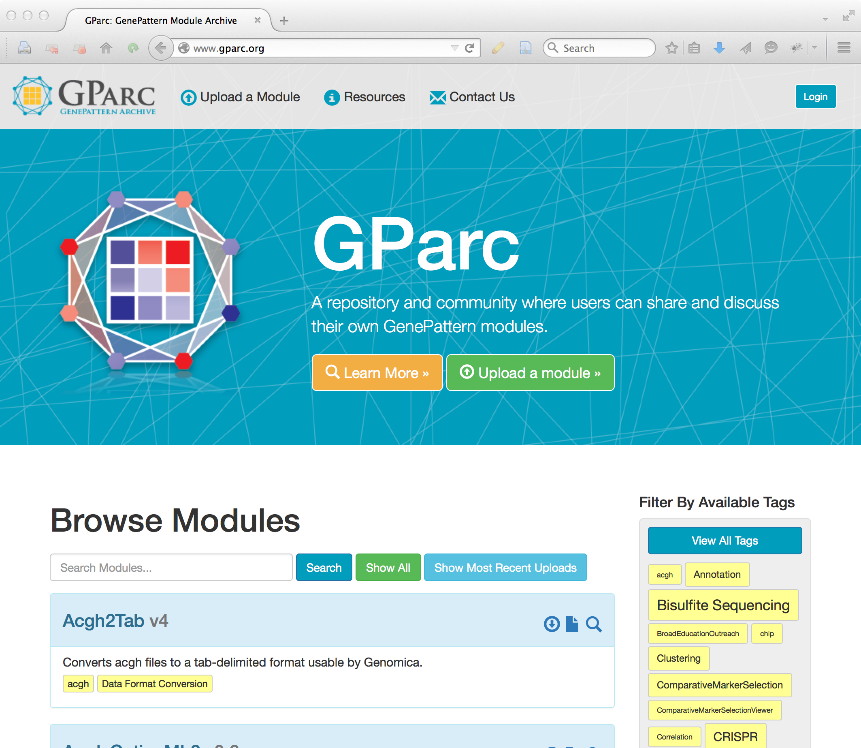
Community Activity
www.genepattern.org
Current version: 3.9.10 (5/2017)
>50,000 registered users
Open source, BSD-style license
Public server runs ~4,000 analyses/week
GParc: GenePattern community repository
~100 community-contributed methods
CRISPR analysis
Bisulfite sequencing
Flow cytometry
RNAi screens
www.gparc.org
Notes:
GenePattern was first released in 2004, and has been updated continually, with the current release being in March and the next release in June.
There are 40,000 users, both who use our hosted server and who have downloaded the software to use at their own organizations.
Our hosted server runs around 4000 analyses per week – these run from simple variation filters to intensive RNA-seq analyses
Our community resource, GParc, has had contributions that have widened the scope of available analyses
Having come to this point, what are the current needs for the integrative genomics community in general and the cancer research community in specific?

Slide 33
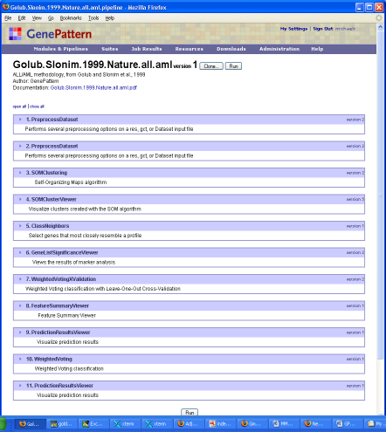
GenePattern vocabulary: Pipelines
all_aml_train
all_aml_test
Preprocess
Dataset
Preprocess
Dataset
SOM
Clustering
Comparative
Marker
Selection
Weighted
Voting
Cross-Validation
Weighted
Voting
Train/Test
SOM
Cluster
Viewer
Comparative
Marker
Selection Viewer
Prediction
Results
Viewer
Prediction
Results
Viewer
Notes:
Another important object is the pipeline. To explain why we need pipelines, let’s say you want to do the following analysis… (demonstrate)
This analysis could serve as the template for other kinds of analyses if you could encapsulate the connections between the modules and make some of the inputs and datasets variable.

Slide 34
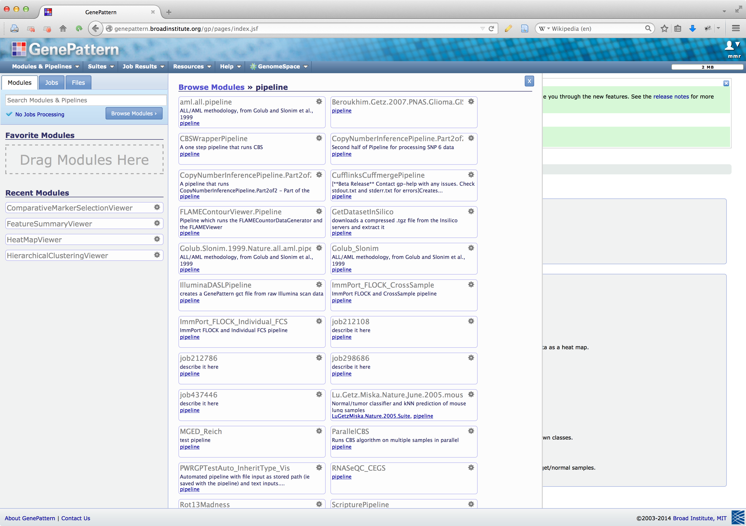
Pipelines in GenePattern
Notes:
In GenePattern, you run a pipeline just like you run a single module.

